Slide 1

MAFS5440 Mid-term Project Presentation
Topic: Predicting Home Credit Default by Using Light Gradient Boosting Model
Authors：
Chen yilin 21230751
Li Xuzhi 21142722
Ming Mei 21271121
Xie Xiaoxiao 21137961

Slide 2

Research Overview
Core Problem:
Predicting probability of "Home Credit" loan default
Highly imbalanced data: Only 8.07% are default cases
Research Objectives:
Compare different models' performance on imbalanced data
Evaluate if multi-table data fusion enhances predictive power
Methodology Approach:
1. Use Logistic Regression as baseline model
2. Compare seven model types including:
Regularized Logistic Regression (L1, L2)
Tree-based Models (Random Forest, GBDT)
Advanced Gradient Boosting (XGBoost, LightGBM)
Support Vector Machines (SVM)
Evaluation:
Use multiple metrics: AUC-ROC, PR-AUC, Brier Score.

Slide 3
Dataset Classification
Source: Home Credit Default Risk (Kaggle)
Three Datasets:
Dataset 1: Contains only training data from application_train
Purpose: Evaluate model performance with minimal data
Focus: Balance between predictive accuracy and computational efficiency
Dataset 2: Training + test data
Excludes: Bureau and bureau_balance datasets
Reason: These tables lack corresponding test set information
Advantage: Comprehensive training while maintaining test set integrity
Dataset 3: All tables (including bureau and bureau_balance)
Includes all available tables merged on SK_ID_CURR
Handling missing data: NaN values for test set bureau features
Rationale:Training:
Uses only customers with known credit history
Test: New customers without bureau data are considered higher risk
Realistic scenario simulation for new applicants

Slide 4
Data Preprocessing Pipeline
Step 1: Feature Space Alignment
Align columns between application_test and application_train
Fill missing columns with NaN values
Goal: Ensure consistent feature space across datasets
Step 2: Feature Type Separation
Separate features into two groups:
Numerical features
Categorical features
Purpose: Enable specialized processing for each data type
Step 3: Missing Value Handling
Training Set:
Numerical features: SimpleImputer with median strategy
Categorical features: SimpleImputer with most frequent strategy
Test Set:
Use median/mode values from training set
Critical: Prevent information leakage during imputation
Step 4: Feature Transformation
Numerical Features:
Standardized using StandardScaler
Applied to: Logistic Regression & SVM models
Categorical Features:
Encoded using OneHotEncoder(handle_unknown='ignore')
Benefit: Handles unseen categories during testing
Step 5: Model-Specific Optimizations
Tree-based Models (LGBM/XGBoost):
No standardization required for numerical features
Can handle original categorical features directly
Advantage: Reduced preprocessing complexity

Slide 5
Models
Logistic Regression model
L1 Regularization (Lasso)
L2 Regularization (Ridge)
Tree-based model
Decision Tree
Random Forest
Boosting Trees model
XGboost
LightGBM
Support Vector Machines model

Slide 6

Logistic Regression model (baseline)
A statistical model widely used in binary classification problems
ADVANTAGES
Simplicity
It is a linear model that is easy to understand and implement, suitable for quickly building preliminary models.
High Interpretability
The model parameters clearly reflect the impact of each feature on the classification results, making them easy to interpret.
Ease of Comparison
Compared to complex models, logistic regression has lower computational costs.
DISADVANTAGES
Imbalanced Data Issue
For a severe class imbalance in the dataset, logistic regression tends to predict the majority class (normal customers), resulting in poor prediction performance for the minority class (defaulting customers)
Linear Assumption
It assumes a linear relationship between features and classes, but in credit default prediction, the relationship between features and classes is often non-linear.
Inability to Capture Complex Patterns
It performs poorly for non-linear relationships and high-dimensional feature interactions, and may fail to capture complex patterns.
Prone to Overfitting
When the data dimensionality is high or the sample size is small, It may overfit.

Slide 7
L1 Regularization (Lasso)
It compress the coefficients of some unimportant features to zero, thus achieving feature selection.
ADVANTAGES
Feature Selection
It can compress the coefficients of some features to zero, automatically selecting features and helping to remove unimportant ones.
Model Simplification
By eliminating redundant features, it helps simplify the model and improve its interpretability.
Improved Generalization
By reducing model complexity, it helps improve the model's generalization ability on new data and reduces overfitting.
DISADVANTAGES
Multicollinearity
For highly correlated features, it may randomly select one feature and remove others, leading to the incorrect removal of important features and underfitting.
Risk of Underfitting
If the regularization strength is too high, it may remove important features, leading to underfitting and affecting the model's predictive performance.

Slide 8
L2 Regularization (Ridge)
It reduces the size of coefficients, thus mitigating the problem of collinearity among features.
ADVANTAGES
Handles Multicollinearity
It can alleviate multicollinearity among features by reducing the coefficients of relevant features, preserving more information.
Stability
It improves model stability, reducing the impact of small fluctuations in training data on model results.
Less Likely to Underfit
It doesn’t compress coefficients to zero like L1 regularization, thus preserving more features and reducing the risk of underfitting.
DISADVANTAGES
No Feature Selection
Unlike L1 regularization, it doesn’t compress feature coefficients to zero, therefore feature selection is not possible, potentially leading to the model including irrelevant features.
Increased Complexity
It preserves more features, which may increase model complexity and thus the risk of overfitting, especially with a large number of features when predicting home credit default.

Slide 9

Decision Tree
It’s suitable for non-linear relationships and do not require data standardization.
Splits use the Gini Index:
ADVANTAGES
Captures Non-linear Relationships
It effectively capture complex non-linear relationships between features and default risk.
Easy to Interpret
It clearly demonstrate the importance of features, making them easy to understand and interpret.
No Need for Normalization
It doesn’t require data standardization and can handle different types of features (continuous and categorical variables).
Accommodate missing values
It can effectively accommodate missing values.
DISADVANTAGES
Sensitivity to Imbalanced Data
The splitting of decision trees is biased towards the majority class, which can result in poor predictive ability for the defaulting customers, thus affecting the overall performance of the model.
Prone to Overfitting
For home default prediction, the data contains many features, and there are complex nonlinear relationships between some features. Decision trees will overfit these features.
Sensitivity to Noise
Housing default prediction data may contain noise (e.g., recording errors), and the decision tree may treat this noise as an important feature during construction.

Slide 10
Random Forests
It improves the overall accuracy of a model by constructing multiple decision trees and combining the predictions of each tree.
Each tree is trained on a bootstrap sample using a random feature subset
at each split.
ADVANTAGES
Reduces Overfitting
It reduces the risk of overfitting from a single decision tree by ensembles multiple decision trees, improving robustness.
Handles High-Dimensional Data
It effectively handles data with a large number of features, especially in credit risk prediction.
Adaptability
It’s adaptable to missing values, enabling predictions with missing data.
Improves Imbalanced Data Performance
On imbalanced datasets, it can improve the predictive ability for the minority class (defaulting customers).
DISADVANTAGES
Lower Interpretability
As the number of trees increases, it becomes more complex and harder to interpret intuitively than a single decision tree.
High Computational Cost
It requires building multiple decision trees, resulting in high computational resource requirements, especially with large datasets.
Inefficient at Handling Highly Sparse Datasets
In home default prediction, features include a great deal of highly sparse information (such as customer history records, credit scores, etc.).
Limited Ability to Capture Complex Feature Interactions

Slide 11

XGboost
It is a gradient boosting algorithm that employs a level-wise strategy, suitable for suitable for handling complex features , non-linear relationships, and imbalanced datasets
, where
ADVANTAGES
Efficient Computation
Provides efficient distributed computing, capable of handling large-scale datasets and accelerating the training process.
Overfitting Prevention
Avoids overfitting through regularization terms, enhancing the model's generalization ability.
Handles Imbalanced Data
It effectively handles imbalanced datasets, suitable for tasks such as credit risk prediction.
Feature Importance
It provides feature importance scores, which help understand the model's decision-making process.
DISADVANTAGES
High Computational Resources
Training time is long, especially during hyperparameter optimization, which may require significant computational resources.
Difficult to Interpret Individual Predictions
As it is an ensemble model, understanding individual predictions is complex.
Sensitive to Noisy Data
It may overfit on noisy datasets.

Slide 12

LightGBM
It is a gradient boosting algorithm that employs a leaf-wise strategy, suitable for large-scale datasets.
Gradient-Based One-Side Sampling(GOSS)
Exclusive Feature Bundling(EFB)
: select important samples
: reduce the dimensionality of the feature space
ADVANTAGES
Faster Training Speed
Due to the leaf-wise strategy, it trains faster than XGBoost on large datasets and high-dimensional features.
Handling High-Dimensional Data
Through GOSS and EFB techniques, it can accelerate training, thus suitable for handling high-dimensional data.
Direct Handling of Categorical Features
It can directly handle categorical features, need no feature preprocessing.
Efficiency
Performs well on large datasets and high-dimensional features, suitable for fast training and prediction.
DISADVANTAGES
Prone to Overfitting
Due to its leaf growth mechanism, it is susceptible to noise, leading to overfitting.
Poor Interpretability
It has poor interpretability; it's difficult to intuitively explain the model's decision-making process.
Training Instability
On some very complex or high-dimensional datasets, its training process may be less stable than XGBoost.

Slide 13

Support Vector Machines
It capture non-linear relationships and it’s suitable for processing high-dimensional data, performing well with small sample sizes and imbalanced datasets.
ADVANTAGES
Adapts to Imbalanced Data
It provides good predictive performance on imbalanced datasets, especially when distinguishing between defaulting and inactive customers.
Handles High-Dimensional Data
By using kernel functions (e.g. RBF kernel), it maps data to a high-dimensional space, thereby it effectively handles high-dimensional data, capturing non-linear relationships in credit default risk prediction.
Effective for Small Datasets
It performs well with small sample sizes, particularly suitable for scenarios with relatively few samples but high feature dimensionality.
DISADVANTAGES
High Computational Complexity
It requires significant computation during training, especially with large datasets, resulting in long training times and high computational resource demands.
Requires Hyperparameter Tuning
Its performance is heavily dependent on parameter settings. Inappropriate parameters can lead to overfitting or underfitting.
Poor Interpretability
It has poor interpretability, particularly when dealing with complex nonlinear relationships. It's difficult to intuitively understand which features are most important.
Sensitive to Extreme Imbalance
While it can handle imbalanced data, in extremely imbalanced scenarios, it may tend to predict the majority class (normal customers), thus affecting its prediction performance for the minority class (defaulting customers).

Slide 14
Methodology
Evaluation Framework
AUC-ROC
PR-AUC
Brier Score
Model Selection
Hierarchical selection criteria
Cross-Validation & Tuning
Class Imbalance Handling
Cross-Validation
Hyperparameter Tuning
Statistical Rigor

Slide 15
Evaluation Framework
AUC-ROC (Overall classification performance)
Area Under the Curve - Receiver Operating Characteristic (ROC)
Reflects the model's ability to distinguish between positive and negative classes.
Used to compare the overall performance of different models.
PR-AUC (Precision-Recall Trade-off)
Measures the performance of a classifier on imbalanced datasets.
Combines precision and recall, effective than AUC-ROC in evaluating a model's predictive ability for the minority class when data is imbalanced.
Brier Score (Probability Calibration)
Evaluates the difference between predicted probabilities and true probabilities.
Used to assess the probabilities calibration effect of a model, ensuring that the predicted probabilities closely approximate the true probabilities of occurrence.

Slide 16
Model Selection
Hierarchical selection criteria
Primary Criterion: Compare AUC Scores
The most important evaluation metric.
Secondary Criterion: Compare PR-AUC Scores
If the AUC difference is less than or equal to 0.005, we compare PR-AUC scores.
In imbalanced data, PR-AUC better assesses the model's performance on the minority class
Threshold 0.005
Based on empirical judgment from the model selection process.
When the AUC difference is between 0.001 and 0.01, we consider their classification abilities to be very similar, therefore we shift to PR-AUC and Brier scores for discrimination.
Third Criterion: Compare Brier Scores
When the PR-AUC difference is also small, we use Brier scores for comparison to ensure the model's probability predictions are reasonable.
Reference
Saito, T., & Rehmsmeier, M. (2015). Precision-Recall Curves and the AUC of the ROC. Journal of Machine Learning Research, 12, 2073-2082. https://journals.plos.org/plosone/article?id=10.1371/journal.pone.0118432
Davis, J., & Goadrich, M. (2006). The Relationship Between Precision-Recall and ROC Curves. Proceedings of the 23rd International Conference on Machine Learning (ICML).https://dl.acm.org/doi/10.1145/1143844.1143874

Slide 17
Cross-Validation & Tuning
Class Imbalance Handling
Model Hyperparameters Setting
Direct Processing
Indirect assistance
Class Weighting
Stratified Sampling (we choose k=3,5)

Slide 18
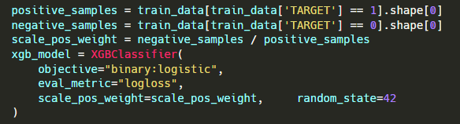

Cross-Validation & Tuning
Class Imbalance Handling
Model Hyperparameters Setting
Used in XGboost model.
Direct Processing
scale_pos_weight: adjust the weights of positive and negative samples
Indirect assistance
subsample & colsample_bytree (searched by Gird Search) : mitigate overfitting caused by reduced model dependence on certain features due to class imbalance
Class Weighting
class_weight="balanced"
By assigning greater weights to the minority class (defaulting customers), allows the model to focus more on the minority class.
Used in Logistic Regression, L1 and L2 regularization, decision tree, Random Forest, LightGBM, and SVM.

Slide 19
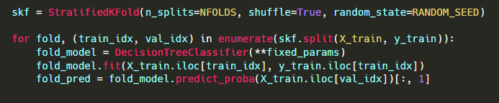
Cross-Validation & Tuning
Class Imbalance Handling
Stratified Sampling (we choose k=3,5)
StratifiedKFold cross-validation
Ensure a consistent class distribution across each fold.
` Used in all models.

Slide 20
Cross-Validation & Tuning
Cross-Validation
Stratified 5-fold cross-validation
Helps us evaluate the model's performance on different dataset subsets, reducing bias caused by a single training set partition, thereby improving model stability.
Used in most models (such as XGBoost, LightGBM, decision trees, etc.)
Stratified 3-fold cross-validation
Because SVM has high computational complexity during training, and using more folds (5 folds) would significantly increase the computational burden.
Used in SVM (Support Vector Machine)

Slide 21
Cross-Validation & Tuning
Hyperparameter Tuning
Grid Search
Tries every possible combination within a given hyperparameter range to find the best-performing combination.
Suitable for models with small hyperparameter spaces or those requiring precise hyperparameter tuning.
Used in decision trees, random forests, and XGBoost models.
Random Search
Randomly selects hyperparameter combinations for evaluation.
Suitable for large hyperparameter spaces, and can find good parameter combinations within a limited time.
Used in SVM and LightGBM model.

Slide 22
Cross-Validation & Tuning
Statistical Rigor
Multiple Cross-Validation Runs for Reliability
Use StratifiedKFold for multiple (3 & 5-fold cross-validation) training and validation cycles to reduce the impact of random errors and data splitting.
Statistical Significance Testing for Model Comparisons
Perform Paired t-test by comparing performance metrics (AUC, PR-AUC, and Brier Scores) of different models.
Paired t-test
A statistical method used to compare two sets of related samples (two models on the same dataset).
H₀: The two models do not differ significantly on this performance metric (mean difference is zero).
H₁: The two models differ significantly on this performance metric (mean difference is not zero).
p < 0.05 is chosen for significance

Slide 23
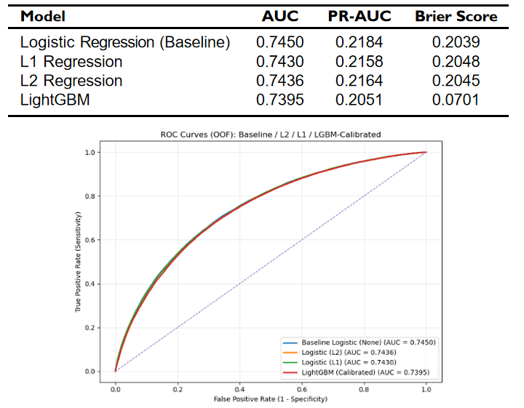
Results for Dataset 1
Performance Scores

Slide 24
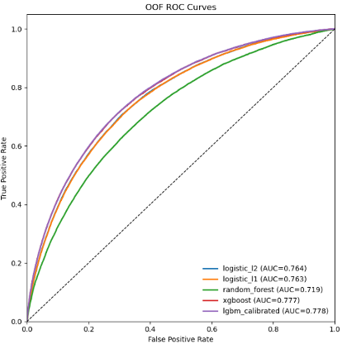
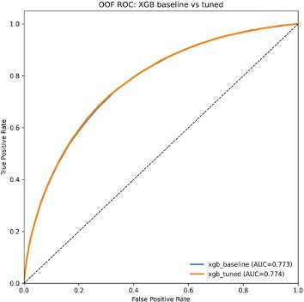
Results for Appending Dataset 2

Slide 25
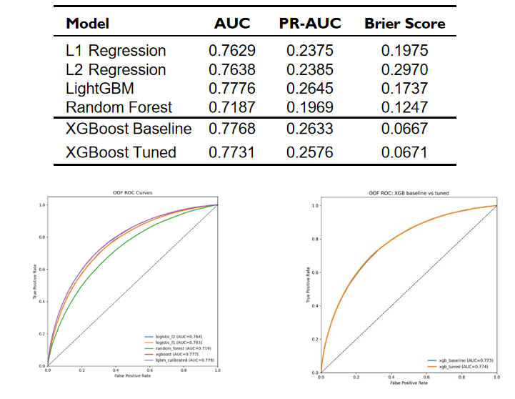
Results for Appending Dataset 2
Performance Scores

Slide 26
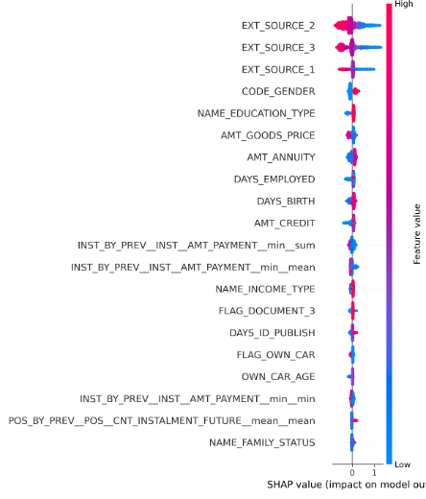
Results for Appending Dataset 2

Slide 27
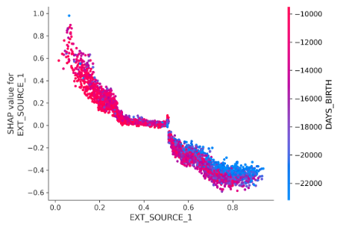
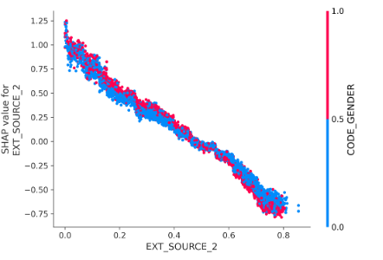
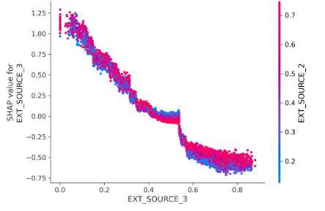
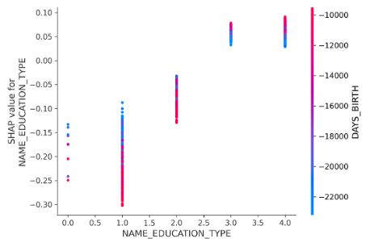
Results for Appending Dataset 2

Slide 28
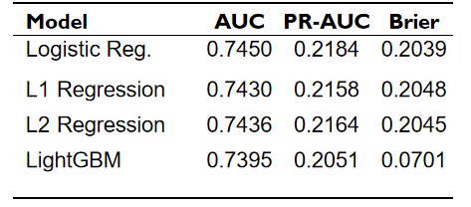
Sub-Summary for Appending Dataset 2
Performance of Dataset 1

Slide 29
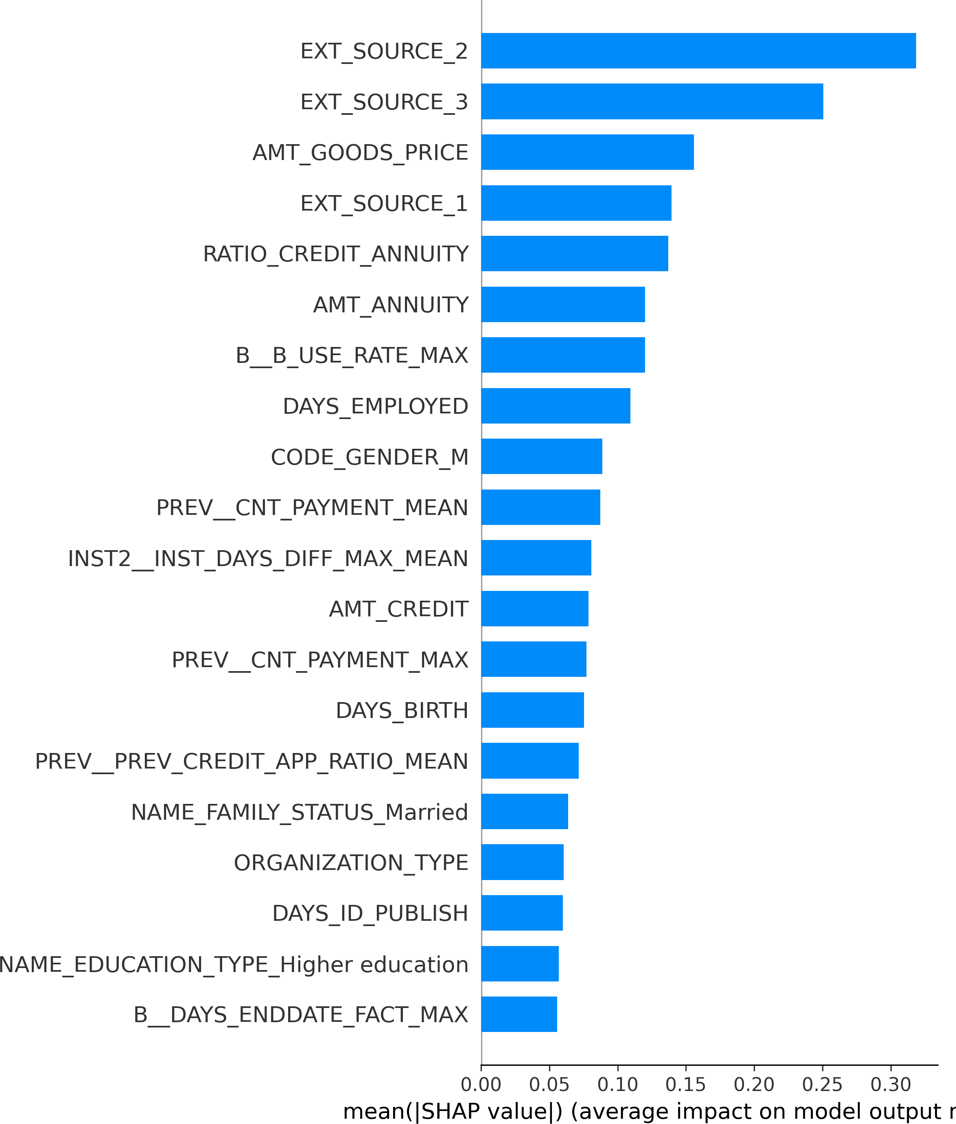
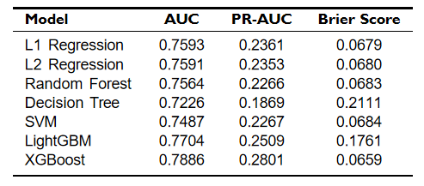
Results for Appending Dataset 3
Performance Scores

Slide 30
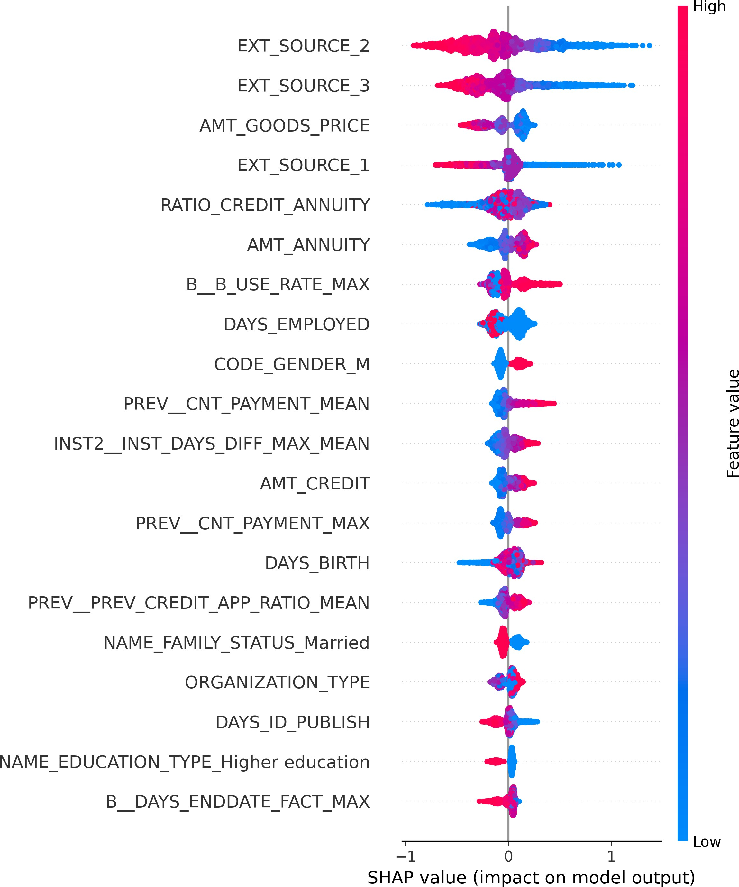
Conclusion
Variables
Features originating from dataset 2 and 3 accounted for approximately 45%.
Installments Payments and Previous Application ranked within top 20.
Installments payments
Detailed installment records.
Previous application
Historical loan records.
Customers’ repayment regularity and credibility.

Slide 31
Conclusion
Model Comparison
XGBoost performs the best in predicting home credit default risk.
Able to handle Large-scale and Imbalanced datasets.
Comapring to LGBM XGBoost has more robust regularization ability to handle overfitting problem.
Tree-based models have obvious efficiency and accuracy advantages comparing to logistic-based models and SVM.
Tree-based models can capture non-linear relationships but have limited improvement.
SVM requires lots of computational power and training time.

Slide 32
Conclusion
XGBoost
Feature Importance → Interpret-ability
External Credit Records, Customer Background Information, Current Financial Status.
Predict-ability ↔ Interpret-ability

Slide 33
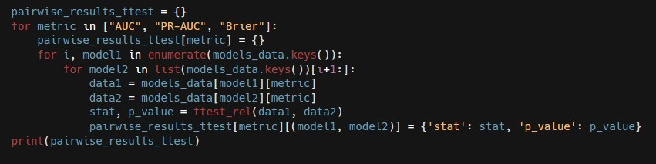
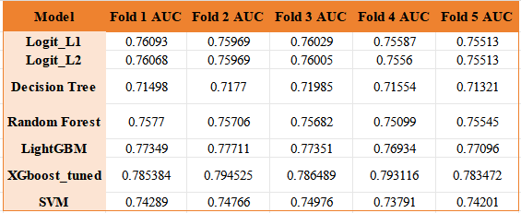
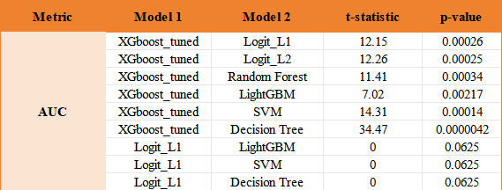
Statistical Significance Testing for Model Comparisons
Paired t-test
Appendix
Model metrics output in Stratified-5-fold Cross-Validation
Model output t-values and
p-values in paired t-test

Slide 34
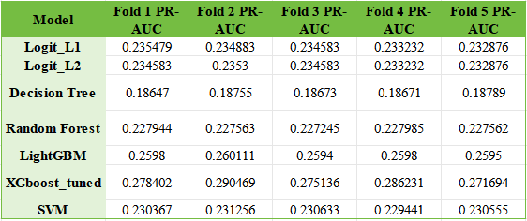
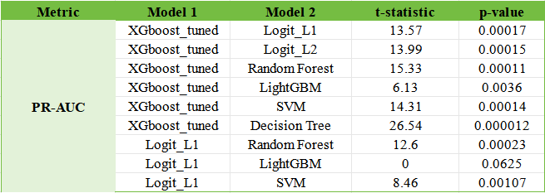
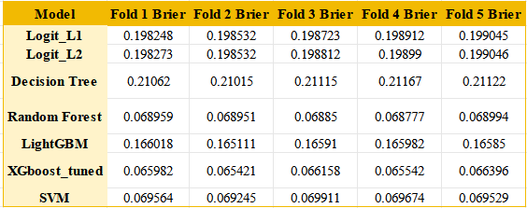
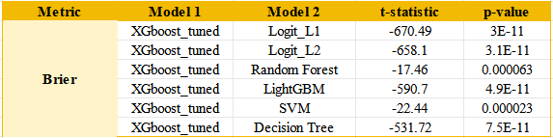
Statistical Significance Testing for Model Comparisons
Paired t-test
Model metrics output in Stratified-5-fold Cross-Validation
Model output t-values and
p-values in paired t-test

Slide 35
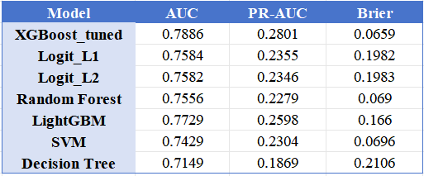
Statistical Significance Testing for Model Comparisons
Paired t-test
Conclusion
XGBoost_tuned performs exceptionally well on all three evaluation metrics (AUC, PR-AUC, and Brier), and its differences from other models are highly significant (where p-values are all small). Based on the combined evaluation metrics and p-values, it is the most superior model among these seven models.

