Slide 1
MAFS 5440 Artificial Intelligence in Fintech Project1: Home Credit Default Risk
Yifei SONG, Jiarui JIANG
Kedeng QIU, Zewen WAN
Hong Kong University of Science and Technology

Slide 2
Topic
Exploratory Data Analysis
Data Processing & Feature Engineering
Information Value Based Feature Selection
Model Construction & Final Score

Slide 3
Exploratory Data Analysis
Main Dataset: application_train.csv
307,511 pieces of clients’ information and 122 features
The pivotal attribute(Target), delineates client’s payment behavior
SK_ID _CURR | TARGET | NAME_ CONTRACT_TYPE | CODE _GENDER | FLAG _OWN _CAR | FLAG _OWN _REALITY | CNT _CHILDREN | AMT _INCOME _TOTAL | AMT _CREDIT | AMT _ANNUITY
100002 | 1 | Cash loans | M | N | Y | 0 | 202500 | 406597.5 | 24700.5
100003 | 0 | Cash loans | F | N | N | 0 | 270000 | 1293502.5 | 35698.5
100004 | 0 | Revolving loans | M | Y | Y | 0 | 67500 | 135000.0 | 6750.0
100006 | 0 | Cash loans | F | N | Y | 0 | 135000 | 312682.5 | 29686.5
100007 | 0 | Cash loans | M | N | Y | 0 | 121500 | 513000.0 | 21865.5

Slide 4
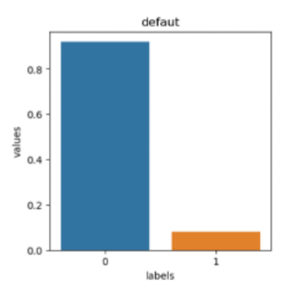
Scatterplot matrix:
Examine the relationships among key variables used in the credit risk model
Exploratory Data Analysis
Imbalance
Notes:
The diagonal plots display the kernel density estimation (KDE) of each variable, while the off-diagonal panels visualize pairwise scatterplots. Several patterns can be observed:
• Positive correlations are evident among EXT_SOURCE_1, predicted_ir, and nn_oof_single_past, suggesting that both internal and neural-network based risk scores are consistent with external credit evaluations.
• AMT_ANNUITY shows a moderate relationship with the predicted risk, indicating potential links between repayment burden and default probability.
• Encoded categorical variables, OCCUPATION_TYPE and ORGANIZATION_TYPE, reveal visible clusters, implying different risk distributions across occupations or organization types.
This visualization helps identify inter-feature dependencies, detect potential multicollinearity, and understand the overall data structure, which informs subsequent feature selection and modeling.

Slide 5
Data Processing & Feature Engineering
How to merge tables Since the primary key (SK_ID_CURR) in the main table appears multiple times in the auxiliary table, we group by the primary key and apply aggregation functions such as 'max', 'mean', 'sum', 'var', and 'median'.
How about Bureau and Balance Since the `bureau_balance` table does not contain `SK_ID_CURR`, we first aggregate it to the `bureau` table using `SK_ID_BUREAU`, and then aggregate the result to the main table using `SK_ID_CURR`.
Then how do we aggregate category columns?

Slide 6
Data Processing & Feature Engineering
Why Label Encoder instead of One-hot Encoder?
High-cardinality categorical features
→
Too many columns, Low efficiency
Binary : Use mean for aggregation
The proportion
Category columns aggregation
Multi-class : Use mode for aggregation
The majority

Slide 7
Data Processing & Feature Engineering
Add some new features :
# Total income to credit ratio — lower ratio = higher debt burden df['INCOME_CREDIT_PERC'] = df['AMT_INCOME_TOTAL'] / df['AMT_CREDIT']
# Annuity to income ratio — repayment burden from income df['ANNUITY_INCOME_PERC'] = df['AMT_ANNUITY'] / df['AMT_INCOME_TOTAL']
# Employment length to age ratio — career stability
df['EMPLOY_TO_AGE_RATIO'] = df['DAYS_EMPLOYED'] / df['DAYS_BIRTH']
# Credit to goods price ratio — checks if loan exceeds product cost
df['CREDIT_GOODS_PERC'] = df['AMT_CREDIT'] / df['AMT_GOODS_PRICE']
# Annuity to credit ratio — repayment speed
df['PAYMENT_RATE'] = df['AMT_ANNUITY'] / df['AMT_CREDIT']
......

Slide 8
Data Processing & Feature Engineering
Main table:
Cleaned abnormal values;
Deleted 4 rows with invalid gender codes;
Added 18 new features.
Bureau and balance:
Data were aggregated through SK_ID_BUREAU and SK_ID_CURR.
Added 10+ new features;
Independently aggregate the columns credit_active and credit_closed
Payment behavior: Added 10+ new features: installment completion ratio/ DPD flags/payment consistency metrics...
Credit card:
Added 10+ new features: Total utilization ratio/Average utilization ratio/Payment ratio...
Previous applications:
Added 7 new features: Application to credit ratio/Application to goods price ratio...
Merge all valid columns from other tables into the main table using the common key column.
Generate 500+ features while maintaining computational efficiency.
Innovation: Memory-efficient encoding strategy with domain-aware financial ratio engineering.

Slide 9
Information Value Based Feature Selection
Missing Value Filtering:
Removed features with excessive missing ratios to ensure data quality.

Slide 10
Information Value Based Feature Selection
Information Value (IV) Screening:
Calculated each features IV against the target
Retained features with IV > 0.02
IV Value Range | Description
IV ≤ 0.02 | No predictive power — should be removed
0.02 < IV ≤ 0.1 | Weak predictive power
0.1 < IV ≤ 0.3 | Medium predictive power
0.3 < IV ≤ 0.5 | Strong predictive power
IV > 0.5 | Very strong predictive power

Slide 11
Information Value Based Feature Selection
PCA (Principal Component Analysis) – Considered but Not Adopted
Maintain Interpretability: We needed to clearly identify
which financial indicators influence the default probability
Low Variance Explained:
Top 10 principal components explained less than 50% of the total variance, indicating information was not well concentrated.
Tests showed that PCA leads to
both information loss and lower scores.

Slide 12
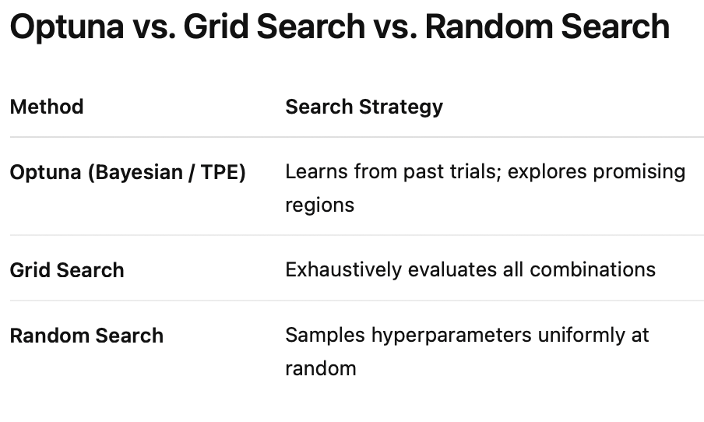
Model Construction & Final Score
LightGBM with Optuna Tuning
- Gradient-boosted trees (LightGBM) tuned via Optuna to maximize OOF AUC
with stratified K-fold CV, early stopping, and median-pruning.
- Hyperparameter search over: num_leaves, min_child_samples, max_depth, feature/bagging_fraction, lambda_l1/l2, learning_rate.
- Achieve results with validation AUC about 0.79

Slide 13
Model Construction & Final Score
Feature importance

Slide 14
Model Construction & Final Score
AutoGluon (Auto ML)
To improve training efficiency and model performance, we used AutoGluon
A multi-layer ensemble learning structure: Bagging + Stacking + Weighted Ensemble
Achieving excellent results: a public score of 0.806 and a private score of 0.797
Model | Method | Score | Weight
LightGBM | Bagging_Fold = 8 | 0.7947 | 0.143
LightGBM + Extra Trees |  | 0.7971 | 0.357
LightGBM | Num_Stack_Levels = 1 | 0.7971 | 0.214
LightGBM + Extra Trees |  | 0.7972 | 0.286
Weighted Ensemble |  | 0.7979 | 1.000

Slide 15
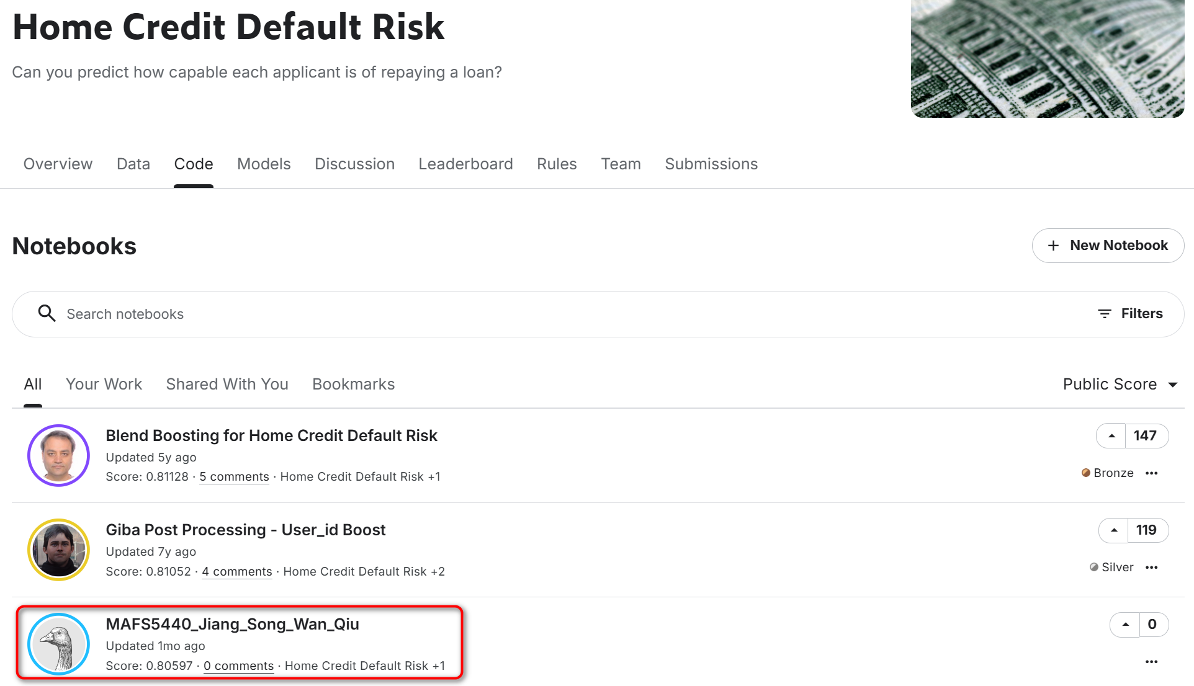
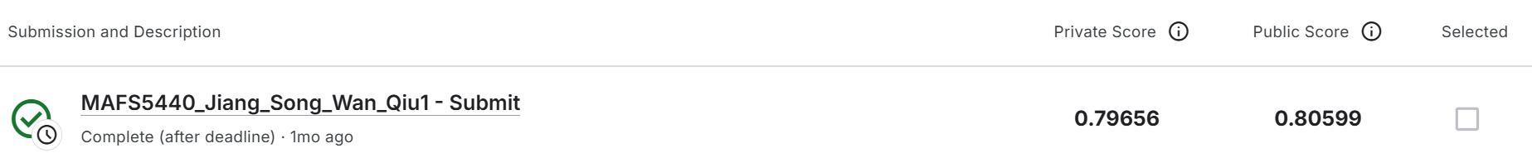
Model Construction & Final Score
Final Score：3rd Highest in All Public Codes

Slide 16
Conclusion
Built a memory-efficient and financially interpretable feature set
Used IV filtering to retain strong predictors and improve data quality
Applied LightGBM + Optuna tuning to achieve AUC ≈ 0.79
Integrated AutoGluon (Bagging + Stacking + Weighted Ensemble)
Final Score: Public - 0.806 Private - 0.797 (3rd place among public)

Slide 17
Contribution
Yifei SONG: Communication, Data Processing & Feature Engineering
Jiarui JIANG: Presentation, Data Processing & Feature Engineering
Kedeng QIU: Organization, Model Construction & Presentation PPT
Zewen WAN: Data Analysis, Feature Selection & Model Construction

