Slide 1
Final Assignment
- Artificial Intelligence in Finance
He Yuhang 20537841
Li Zhuxuan 20540549

Slide 2
Codecademy
Investment Analysis

Slide 3
Brief Introduction
Codecademy is a web- and mobile-based platform that mainly provides users programming courses.
As Codecademy focuses mainly on programming courses, we set the main competitor analysis on those online platforms that mainly provide programming courses and with similar characteristics.
After research, we choose three competitors of Codecademy: w3schools, Code School and Coursera.

Slide 4
From online study company’s aspect, KPI can be the product itself (including learning contents and designing & convenience ) and products’ price.
From investors’ aspect, we still focus on company’s promotion, which indicates its future amount of users and expanding ability, and financing situation.
Comparison Analysis
Learning Contents
Product
Designing & Convenience
Price
Company managers
Promotion
Number of Visitors & Members
Financial Analysis
Financing situation
(Expanding ability)
(Source of Income)

Slide 5
Product
Learning Contents
Designing & Convenience

Slide 6
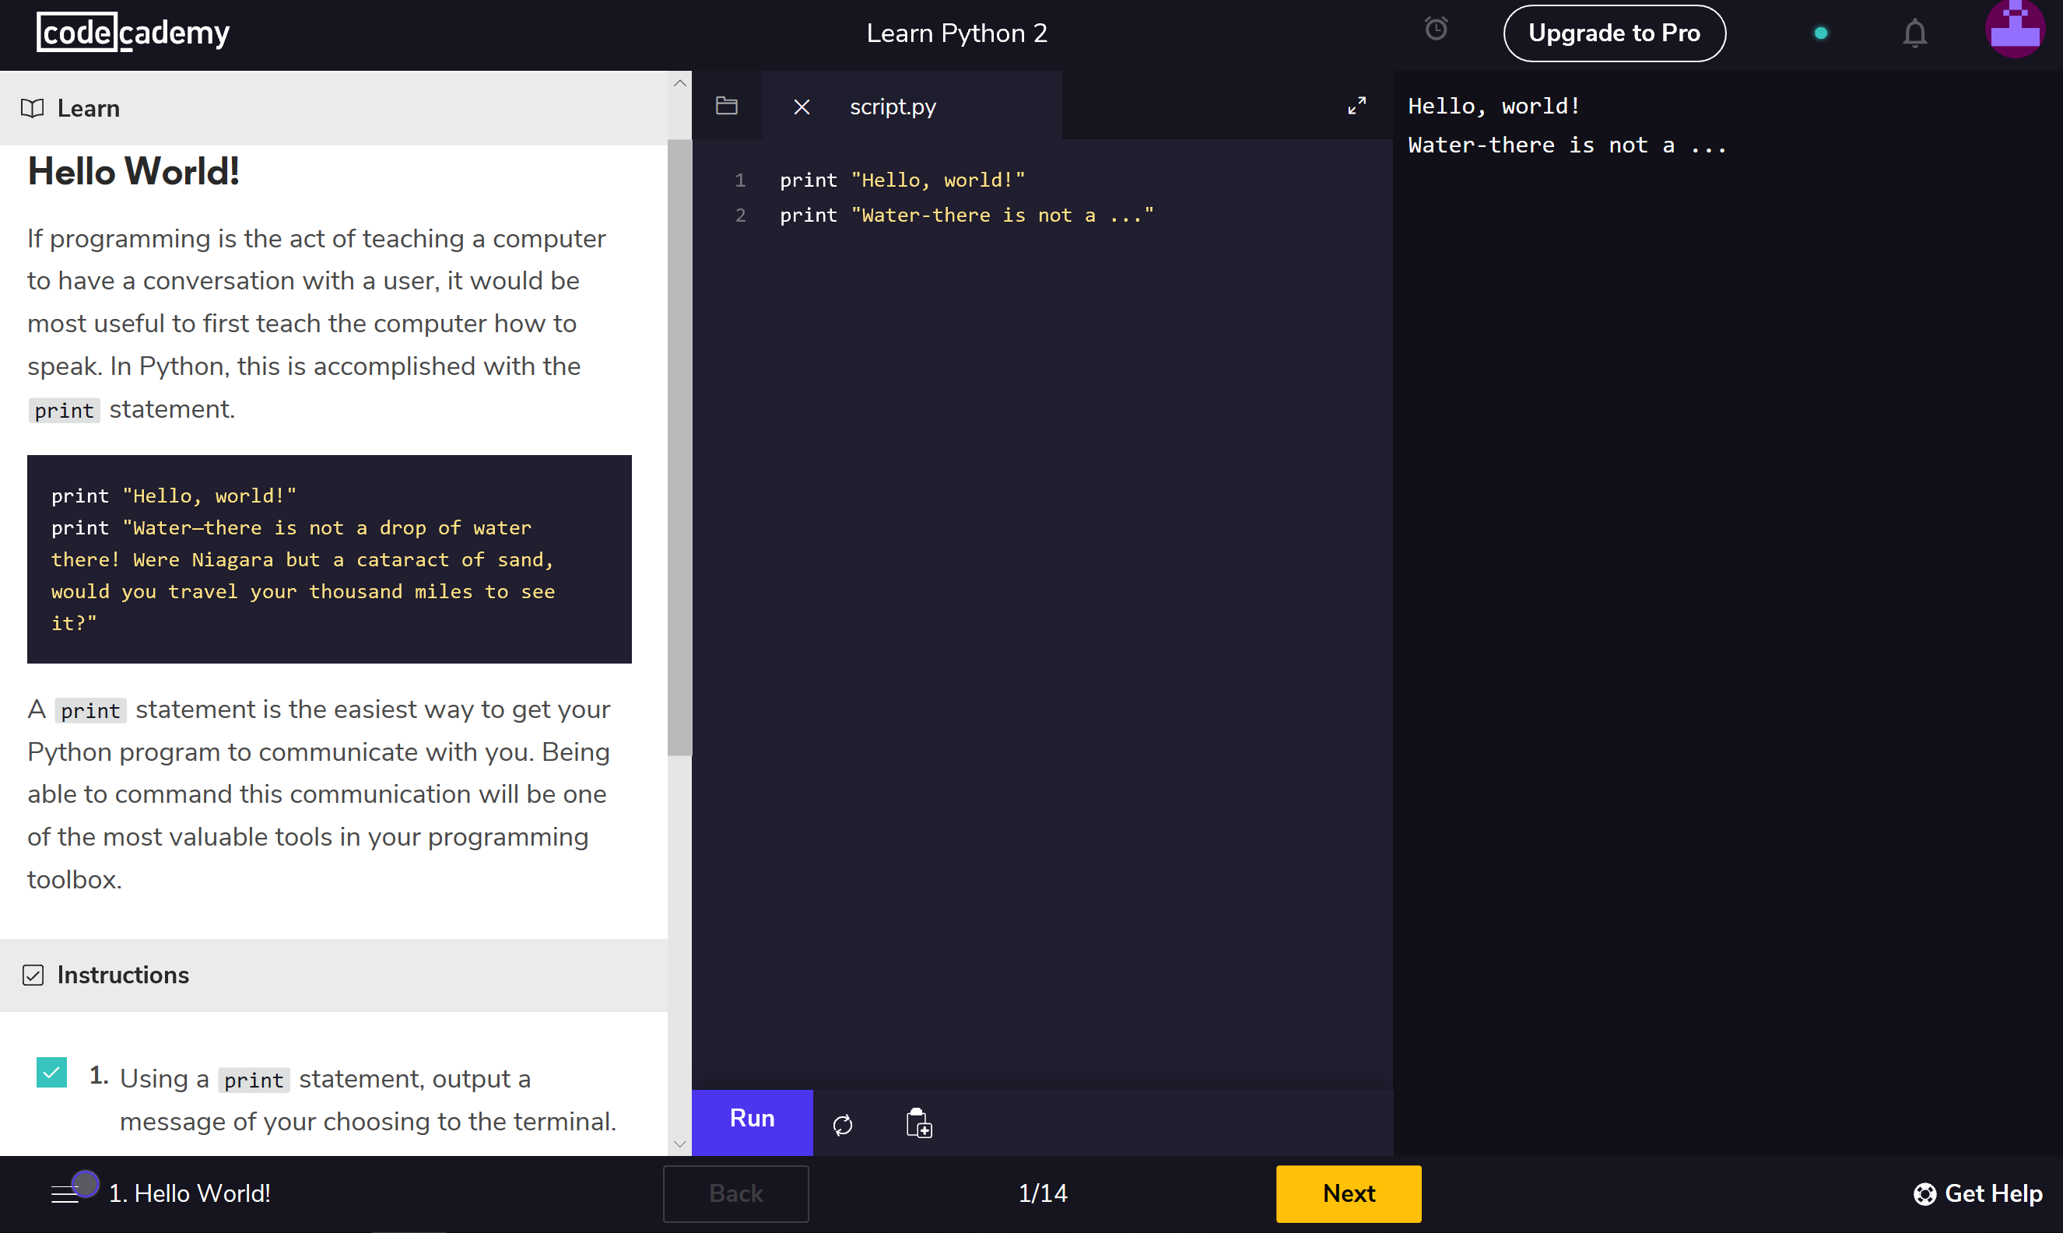
Learning Contents
1. Codecademy
Codecademy provides free and non-free programming courses for users.
Free courses: a) basic knowledge about programming (comprehensive); b) languages are rich: python, C++, HTML, JavaScript, PHP, Ruby; c) easy to use (the learning interface is divided into three columns: the first column is the guide, the second column is the input area and the third column shows the result).
Non-free courses: further study of coding language.
Target users: people who want to learn systematic programming and do not learn about programming before.
Score:

Slide 7
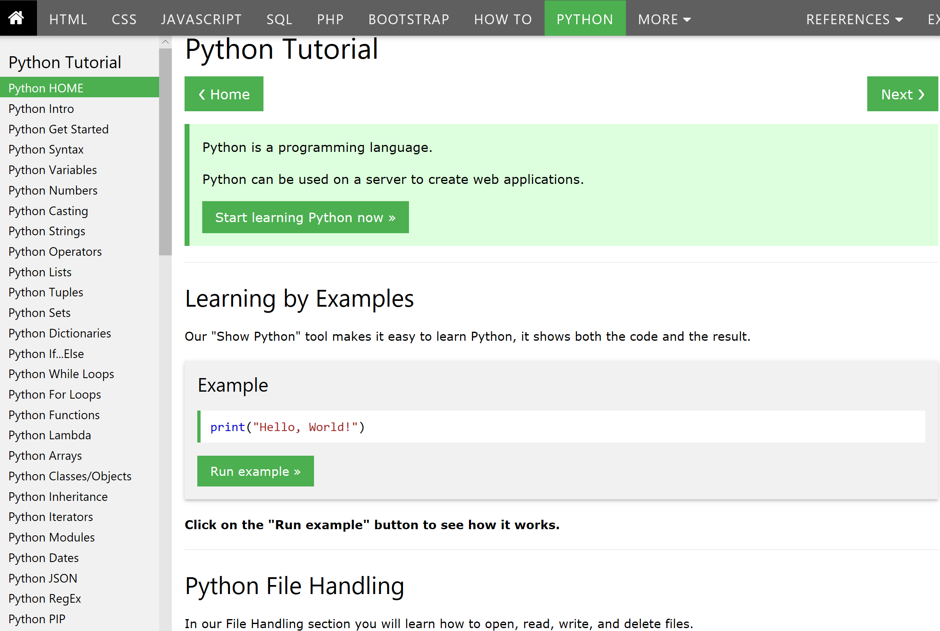
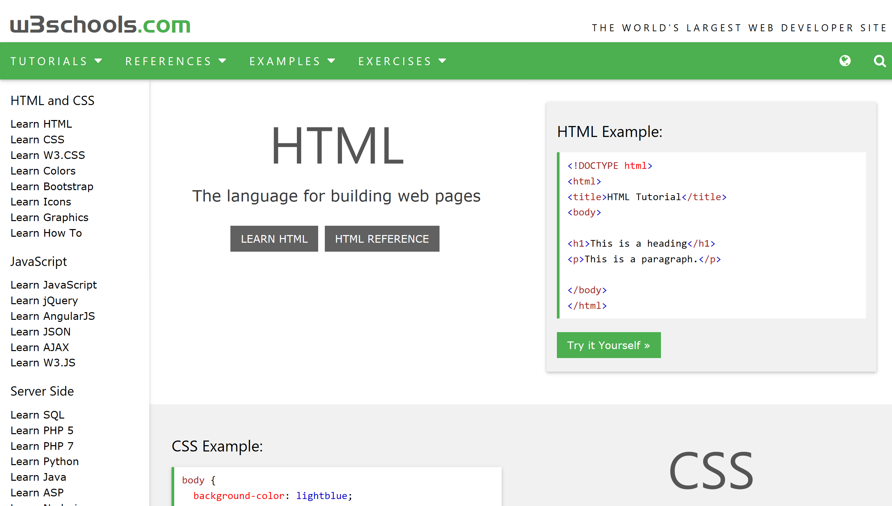
Learning Contents (Cont.)
2. w3schools
W3schools is an online platform that provides its users with education related to web development. It provides its users with tutorials related to HTML, HTML5, CSS, CSS3, Java, JavaScript, jQuery, jQueryMobile, AngularJS, AJAX, JSON, SQL, PHP, ASP, ASP.NET, VBScript, AppML, XML Tutorials, WEB Building, and more.
Free tutorials: a) knowledge about programming (comprehensive); b) w3schools provides a lot of related useful references; c) languages are rich: HTML, CSS, JavaScript, PHP, SQL, Python, jQuery, Java.
Target users: people who want to learn programming, mainly focus on web developer and those who have patience.
Score:

Slide 8
Learning Contents (Cont.)
3. Code School
Code School provides programming courses for users. Different from other courses, these courses are famous for practical use.
Non-free courses: 1) languages are rich: HTML, CSS, JavaScript, PHP, SQL, Python, jQuery, Java; 2) courses it provides characterized by practicality.
Target users: people who want to learn programming and related knowledge, especially those who need to use these knowledge in practice now.
Score:

Slide 9
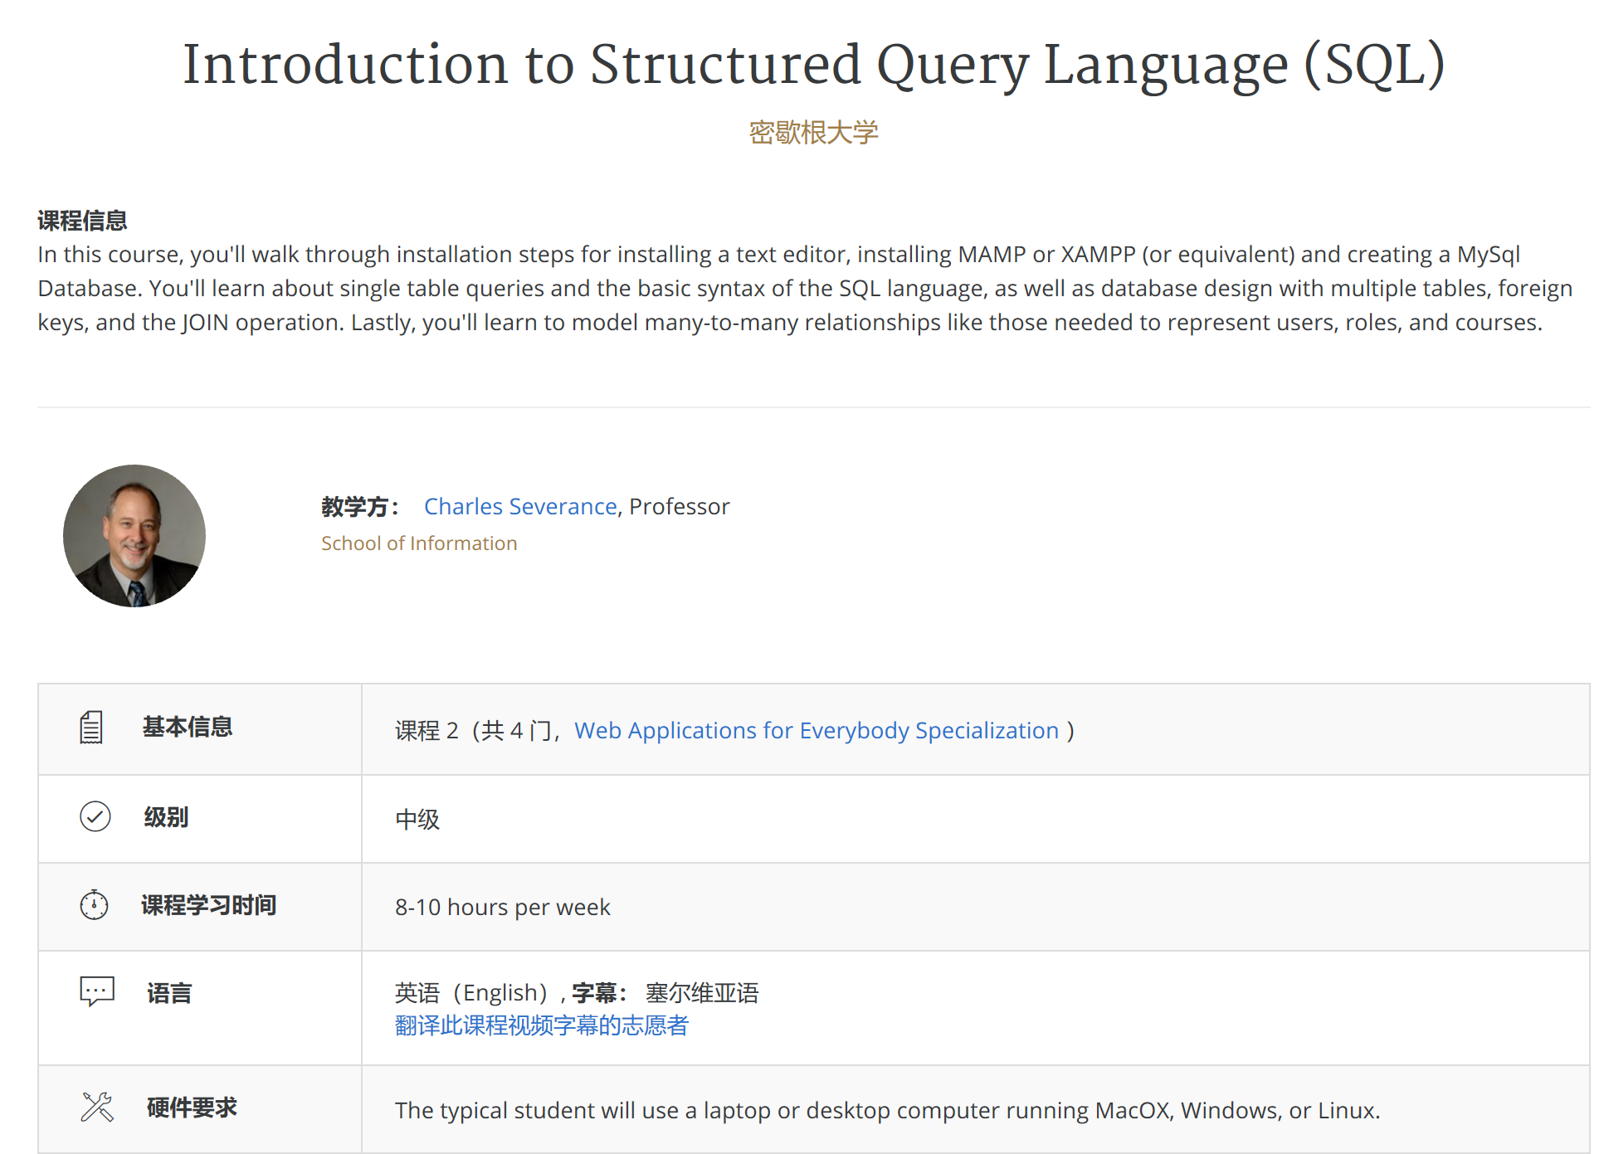
Learning Contents (Cont.)
4. Coursera
Coursera provides free (mainly) and non-free courses in many fields (not only programming) for users and these courses are provided by famous universities around the world.
Free courses: a) knowledge about all fields; b) provided by famous universities such as MIT, Harvard (high quality); c) In programming field, languages are rich: HTML, CSS, JavaScript, PHP, SQL, Python, jQuery, Java.
Target users: people who want to learn all courses including programming.
Score:

Slide 10
1. Codecademy
Simple, clear and beautiful designing, users can easily sign up or look through the price. However, it takes some time to find some information about courses.
Score:
Designing &
Convenience
2. w3schools
Simple designing, users can easily find language courses on the left. There are some programming examples on the web page. Not beautiful and filled of advertisements.
Score:

Slide 11
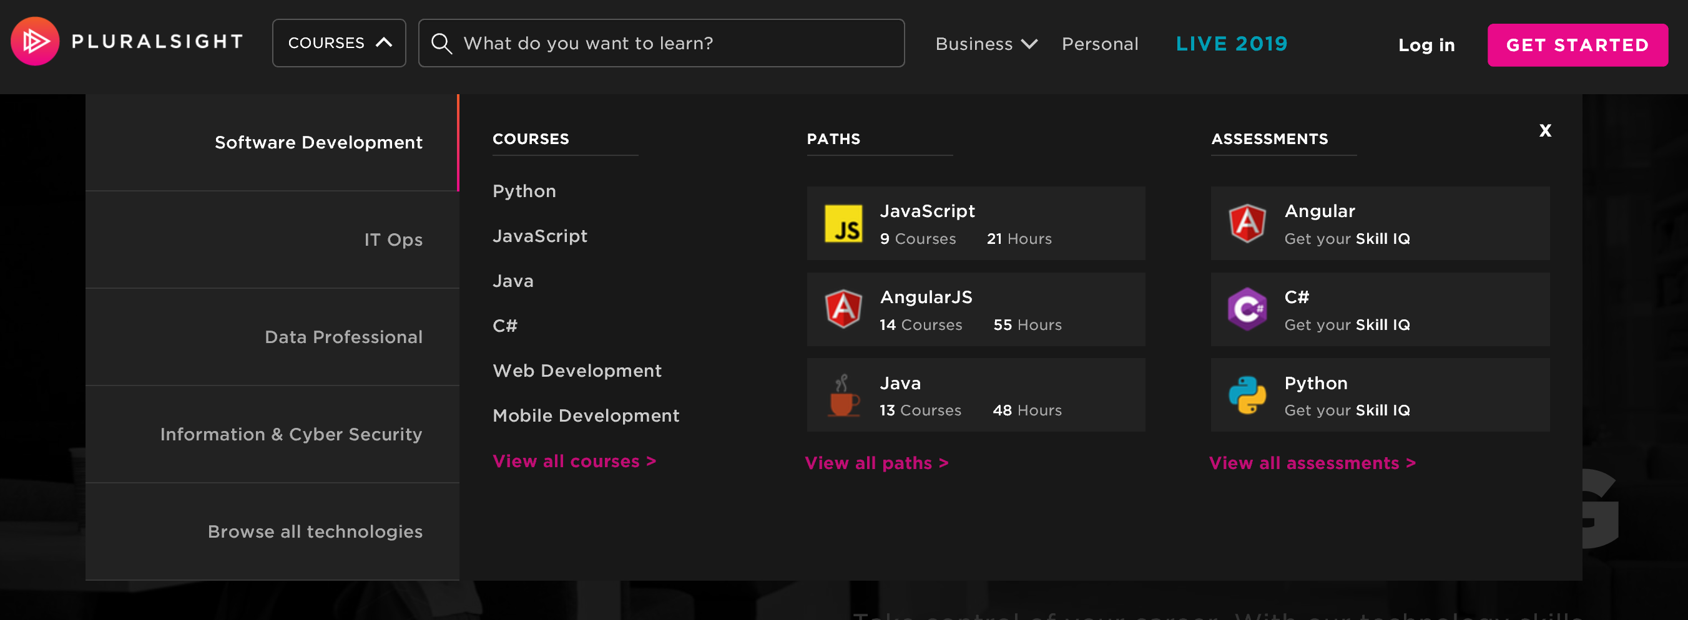
Continue
3. Code School
Cool, simple designing, users can easily look through all services it provide via the category. The whole web design is black which gives users a professional feel.
Score:
4. Coursera
Simple, clear designing, users can easily look through all services it provides and the course information.
Score:

Slide 12
Price

Slide 13
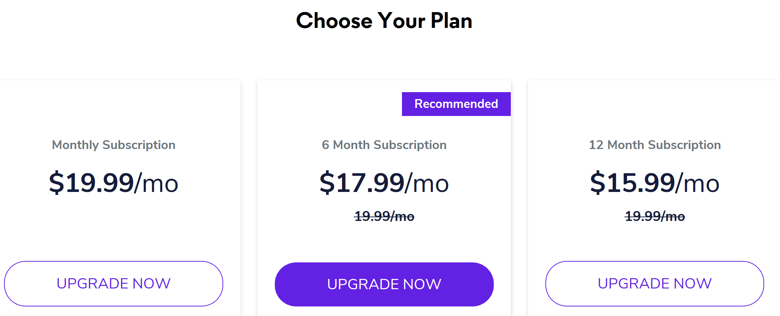
Price of Membership
1. Codecademy
$15 – 20 per month, cheap
Unlimited access to Codecademy course and paths, and other premium features
Score:
2. w3schools
All tutorials are free, users can get useful resources (references) for free
Score:

Slide 14
Price of Membership
3. Code School
4. Coursera
Monthly US$29
Annual US$299
Entire courses library
Learning paths
Channels
Skill IQ
Role IQ
Courses learning checks
Course discussions
Exercise files
Mobile and TV apps
Offline viewing
Premium Membership
Annual US$449
All general features
Extra:
Certification practice exams
Interactive courses
Projects
Most courses are free if users choose audience mode. If users need a certification, it charges some money.
Score:
$25 – 40 per month, expensive
Score:

Slide 15
Promotion
Company managers
Number of Visitors & Members
Expanding ability

Slide 16
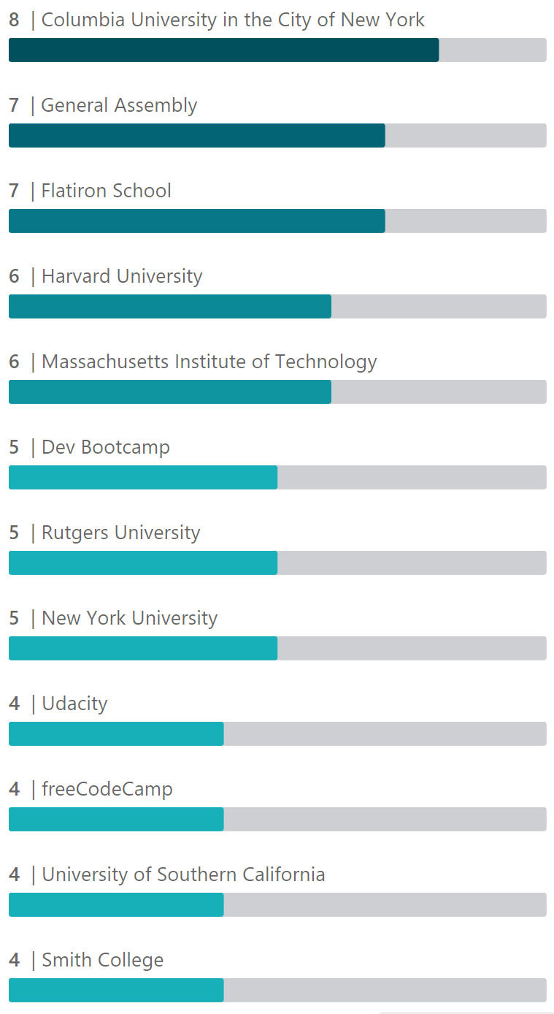
Managers & Employees
Codecademy
Employees Education Background
Education
Columbia University in the City of New York
B.A. Political Science
Experience
Codecademy | Co-Founder & CEO
Jun 2011 – Present
Bowery Capital | Venture Partner
May 2013 – Present
Co-Founder & CEO
Education
Columbia University in the City of New York
Biophysics, Computer Science
Experience
Several Startups Advisor
2015 – Present
Codecademy | Co-Founder
Jun 2011 – Present
Co-Founder
Founders (and employees) of Codecademy have good education background and are young.
Score:

Slide 17
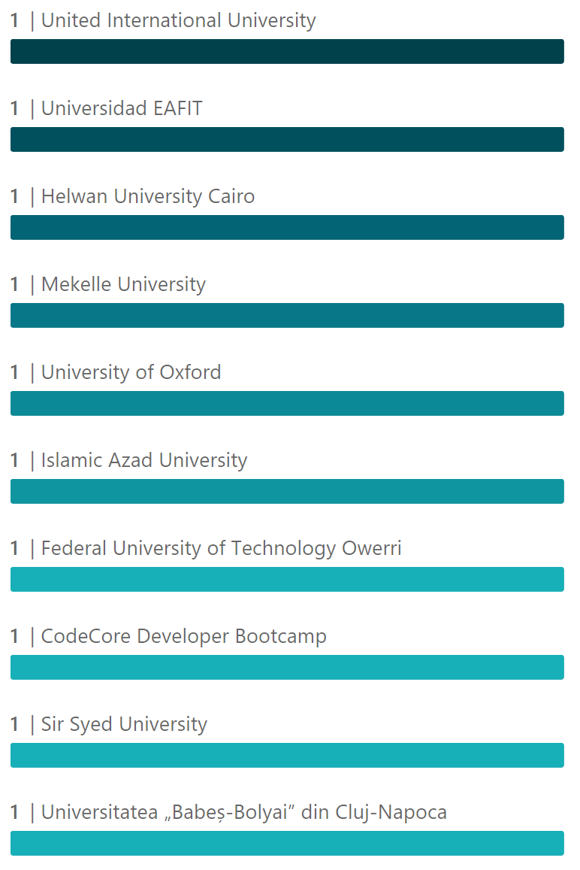
Managers & Employees
w3schools
Employees Education Background
Education background of employees at w3schools are varied.
Score:

Slide 18
Managers & Employees
Code School
Code School was acquired by Pluralsight and the managers information are about Pluralsight.
Aaron Skonnard is the CEO of Pluralsight, a fast-growing enterprise technology skills platform. Aaron cofounded Pluralsight in 2004 and has since grown the company to more than 600 employees and 1,500 expert authors. As CEO, Aaron focuses on business strategy, future direction, product development and strategic partnerships. On a day-to-day basis, he works closely with the entire executive team in different capacities, including recruiting, brand management, marketing, sales, feature planning and content acquisition.
Founder & CEO
Arne Duncan is currently a Managing Partner at the Emerson Collective, a non-profit organization founded by Laurene Powell Jobs focused on improving the quality of public education, advancing immigration reform, and supporting and scaling social innovation. Having served as the U.S. Secretary of Education from 2009 to 2016, Duncan is one of the most notable and highly-regarded thought leaders of twenty-first century education. One of the longest-serving education secretaries and arguably the most influential, he guided a rapid expansion of the federal role in the nation’s 100,000 public schools and saw 40 states adopt key policies.
Managing Director
Managers of Code School (Pluralsight) are very experienced.
Score:

Slide 19
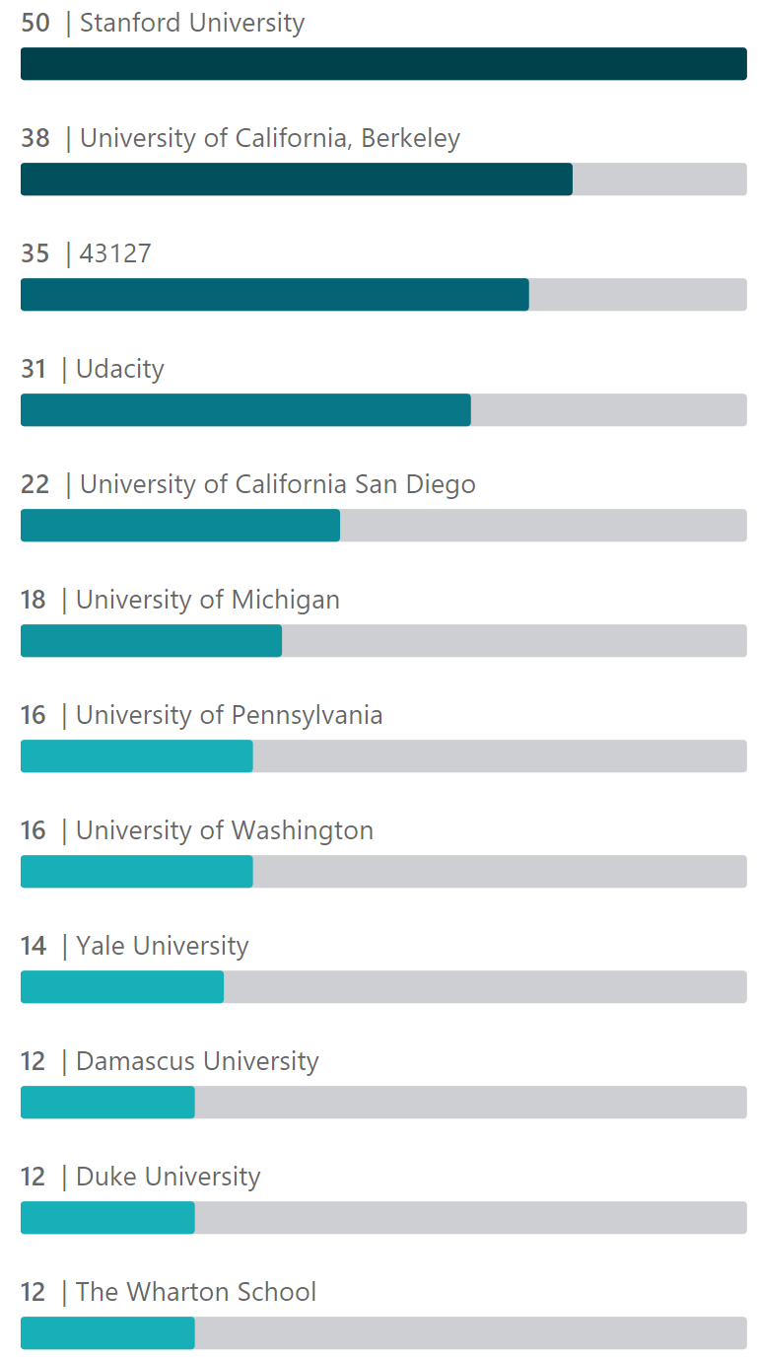
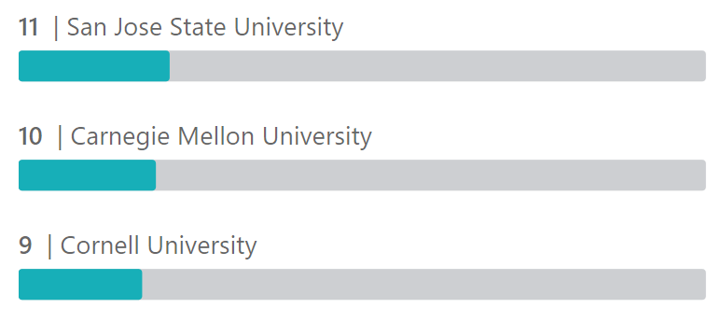
Managers & Employees
Coursera
Daphne Koller co-founded Coursera in 2012. She served as the company’s Co-CEO until 2014, and then as President until 2016. Daphne has recently founded Insitro which applies machine learning techniques to drive innovation in the area of life sciences. Before Insitro, Daphne served as Chief Computing Officer of Calico Labs, an Alphabet (Google) company using advanced technology to understand aging. Before founding Coursera, Daphne was the Rajeev Motwani Professor of Computer Science at Stanford University, where she served on the faculty for 18 years. She is the author of over 200 refereed publications, and has been honored with multiple awards and fellowships, including the Presidential Early Career Award for Scientists and Engineers (PECASE), the ACM Prize in Computing, the MacArthur Foundation Fellowship, and the Cox Medal for excellence in fostering undergraduate research at Stanford; she was also recognized as one of TIME Magazine’s 100 most influential people in 2012.
Employees Education Background
Co-Founder
Jeff Maggioncalda joined Coursera as CEO in June 2017. He previously served for 18 years as the founding CEO at Financial Engines Inc, a company co-founded by economist and Nobel Prize winner William Sharpe. Financial Engines grew rapidly under Jeff's leadership, providing high-quality online investment advice that has helped millions of people save and prepare for retirement. Jeff has also worked as a consultant at McKinsey & Company and Cornerstone Research, and continues to serve as a Director of Silicon Valley Bank, Inc. He holds an MBA from the Stanford Graduate School of Business and a Bachelor's degree in Economics and English from Stanford University. In his free time, Jeff is a lifelong learner and proud dad, and enjoys studying music theory and spending time with his wife and three daughters.
CEO
Founders, managers and employees of Coursera are very good educated and experienced.
Score:

Slide 20
Number of Visitors & Members
The amount of daily or monthly visitors of these online education platform is important to analyze the investment of these platforms as these data can provide the information of 1) the marketplace of the company; 2) the trends of these numbers indicate the future development of the platform.
However, the exact data need to be collected from due diligence of these companies as they are not available for public.

Slide 21
Financial Analysis
Financing Situation

Slide 22
Financing Situation
1. Code Cademy
Announced Date | Transaction Name | Investors | Money Raised
Jul 12, 2016 | Series C | Index Ventures, Flybridge Capital, Union Square Ventures, Naspers, Virgin Group | $30M
Apr 25, 2014 | Convertible Notes | Flybridge Capital | $5M
Jun 18, 2012 | Series B | Kleiner Perkins, Index Ventures, Union Square Ventures, Alexis Ohanian, Virgin Group | $10M
Oct 27, 2011 | Series A | Y Combinator, SV Angel, Slow Ventures, Founder Collective, Union Square Ventures and other 4 companies | $2.5M
Investment suitability:
2. Code School
Code school was acquired by Pluralsight on Jan 26, 2015 at $36M.
Investment suitability: Not applicable.

Slide 23
Financing Situation
3. Coursera
Announced Date | Transaction Name | Investors | Money Raised
Apr 25, 2019 | Series E | New Enterprise Associates, Future Fund, SEEK Group | $103M
Jun 7, 2017 | Series D | New Enterprise Associates, Kleiner Perkins, Learn Capital, G Squared, EG Capital Advisors and other 2 companies | $64M
Apr 10, 2017 | Series D | — | —
Oct 27, 2015 | Series C | Learn Capital, EDBI, IFC Venture Capital Group, G Squared, Black River Ventures and one other company | $11.6M
Aug 25, 2015 | Series C | New Enterprise Associates, Kleiner Perkins, International Finance Corporation, Times Internet | $49.5M
Nov 24, 2013 | Series B | Learn Capital, GSV Capital, IFC Venture Capital Group | $20M
Jul 10, 2013 | Series B | International Finance Corporation, Learn Capital, GSV Capital, THE WORLD BANK GROUP, Laureate Education, Inc. | $43M
Jul 17, 2012 | Series A | New Enterprise Associates, Kleiner Perkins | $6M
Apr 18, 2012 | Series A | New Enterprise Associates, Kleiner Perkins | $16M
Investment suitability: (Not suitable for venture investment)

Slide 24
Further Efforts
As time is limited and information are not all available, further efforts are needed to complete a perfect investment analysis.
Product: collect users’ feedback.
Promotion: 1) estimate companies’ expanding ability; 2) do researches on companies’ strategy and marketing power.
Financial analysis: investigate companies’ income sources and their P&L status.

Slide 25
My
Thinking
The best business status of a professional online education website is that when people think of studying a subject within this field, they will first think of this brand. For example, in China, when people (both students and working people) think of studying CFA or CPA, they will first think of Golden Future or Gaodun.com.
More detailed information about CodeCademy need to be collected by due diligence to analyze it before investing. From the information collected, CodeCademy worth investing for 1) online education mode will be the future trend because of its convenience and effectiveness; 2) data science including programming will keep popular in the near future; 3) Codecademy itself provides effective and cost-efficient learning materials; 4) Codecademy still has the need and possibility to continue financing; 5) Codecademy still has the possibility to expand in the future.
If possible, take some right to manage the company after investing it.

Slide 26
Thank you for watching!

