Slide 1
Bitcoin trading strategies using news and tweets with sentiment analysis
Proudly presented by Team Hongkies from MAFS6010U

Slide 2
Overview
Background and Purpose of this project
Sentiment Analysis Model – VADER
Data Preparation
Bitcoin historical price
Bitcoin related news from Coindesk
Tweets with hashtags “BITCOIN” or “BTC”
Bitcoin Price Prediction Model & The proposed trading strategy
Train the linear regression/ logistic regression model using Tweets and Bitcoin related news
Backtesting Result
Discussion on the result and further work

Slide 3
Background and Purpose of this project
Traditional methods to predict security price movement such as technical analysis and fundamental analysis have been widely studied and it is pretty hard to identify new and useful indicators to beat the market.
With recent developments on AI (“Artificial Intelligence”), analyzing unstructured data including texts become possible leveraging the techniques of NLP (Natural Language Processing).
Cryptocurrency is a relatively new digit asset with growing popularity since 2016. The drastic climb of bitcoin price from less than USD1,000 to USD20,000 in 2017 has provided a lot of investment opportunities.
The purpose of this study is to construct some bitcoin trading strategies with unstructured data.

Slide 4
Sentiment Analysis Model - VADER
VADER (Valence Aware Dictionary and sEntiment Reasoner) is a lexicon and rule-based sentiment analysis tool that is specifically attuned to sentiments expressed in social media. It is fully open-sourced.
Introduced in 2014, VADER text sentiment analysis uses a human-centric approach, combining qualitative analysis and empirical validation by using human raters and the wisdom of the crowd.
How does Vader work?
It relies on a dictionary which maps lexical features to emotion intensities called sentiment scores.
Emotion intensity or sentiment score is measured on a scale from -4 to +4, where -4 is the most negative and +4 is the most positive.
The sentiment score of a sentence is calculated by summing up the sentiment scores of each VADER-dictionary-listed word in the sentence.
VADER sentiment analysis returns a sentiment score of a sentence in the range -1 to 1, from most negative to most positive using the normalization technique.
Source: http://datameetsmedia.com/vader-sentiment-analysis-explained/, https://github.com/cjhutto/vaderSentiment

Slide 5
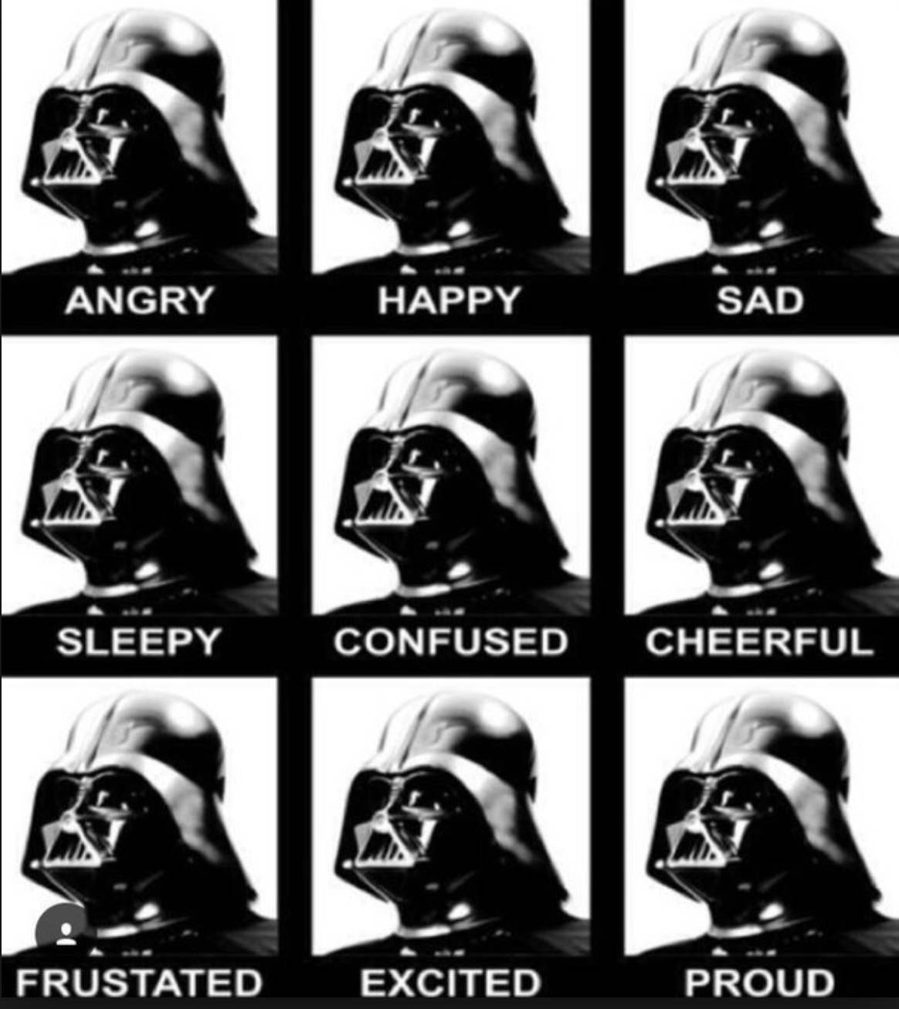
Sentiment Analysis Model - VADER
Example:
“The food is good.”
VADER scores: 'neg': 0.0, 'neu': 0.452, 'pos': 0.548, 'compound': 0.5622
"The food is GOOD!”
'neg': 0.0, 'neu': 0.433, 'pos': 0.567, 'compound': 0.6027
"The food is really GOOD!”
'neg': 0.0, 'neu': 0.487, 'pos': 0.513, 'compound': 0.6391
"The food is really GOOD! But the service is dreadful.”
'neg': 0.192, 'neu': 0.529, 'pos': 0.279, 'compound': 0.3222
Source: http://t-redactyl.io/blog/2017/04/using-vader-to-handle-sentiment-analysis-with-social-media-text.html

Slide 6
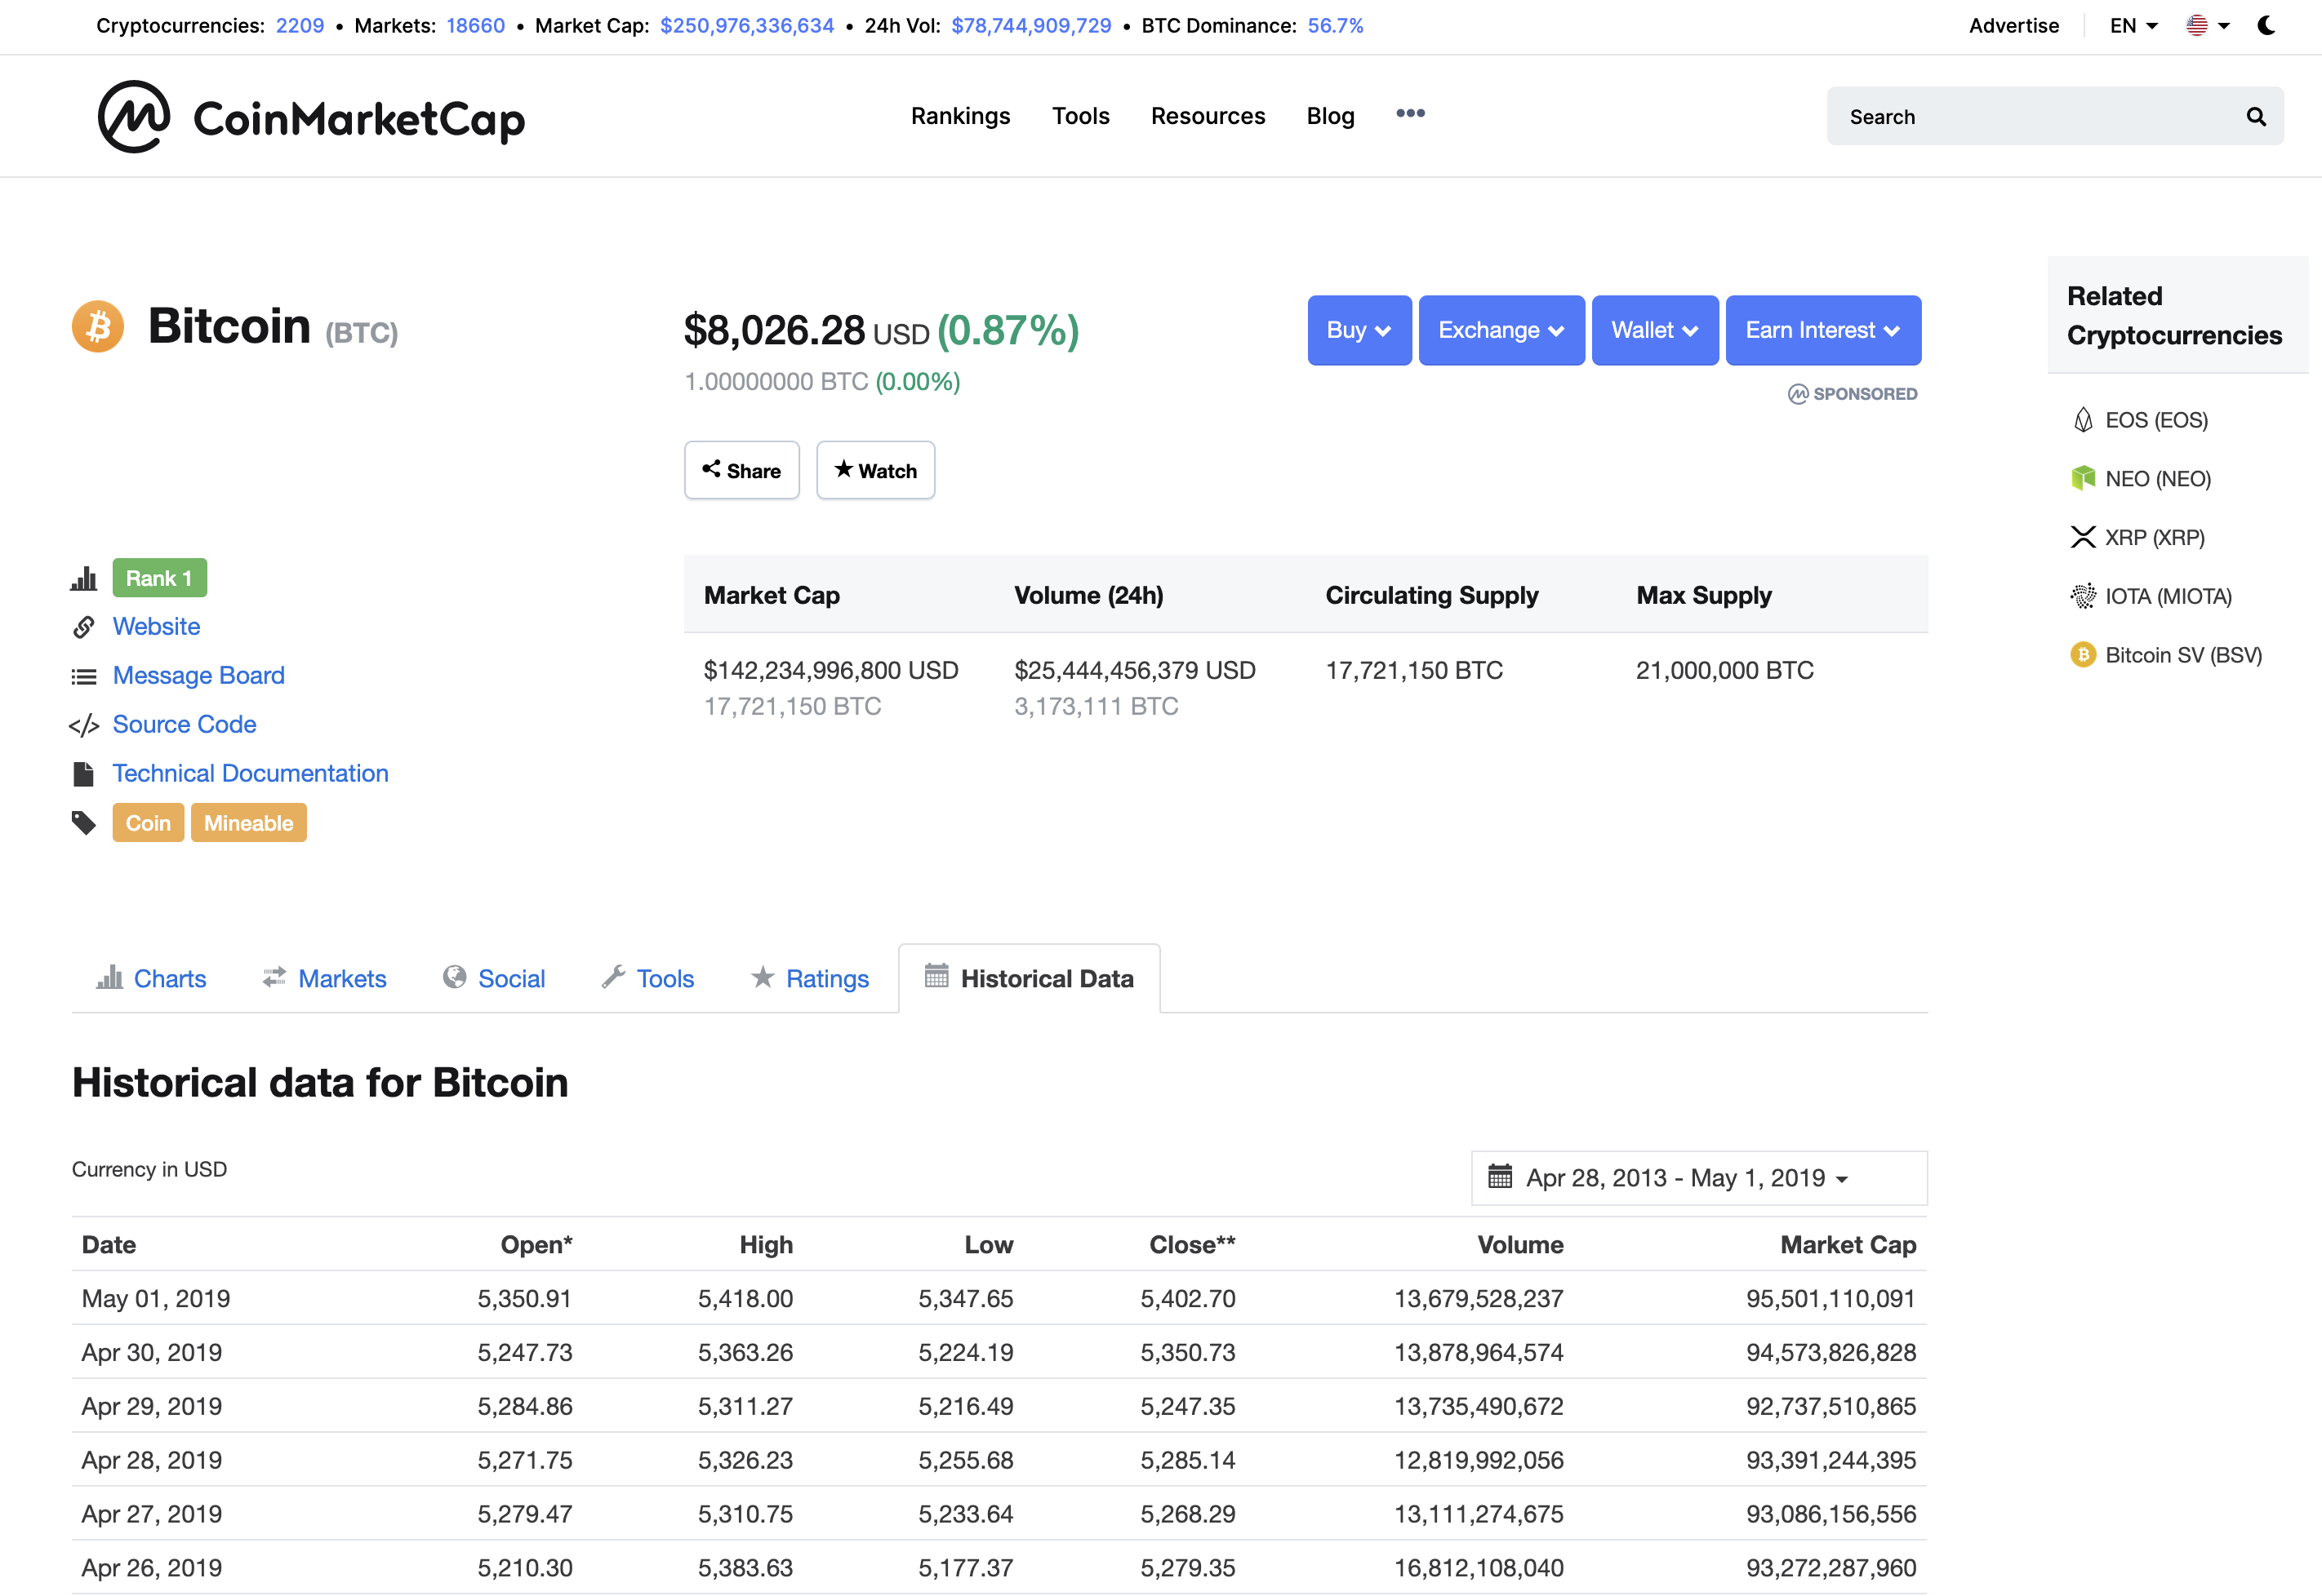
Data Preparation – BITCOIN MARKET DATA
The bitcoin market data is downloaded from CoinMarketCap
The daily return/ log return of bitcoin is computed by using the historical Open Price
Source: https://coinmarketcap.com/currencies/bitcoin/historical-data/

Slide 7
Data Preparation – Bitcoin related news in Coindesk
Coindesk is a news site specialized in bitcoin and cryptocurrencies.
The historical news is retrieved from Coindesk using the technique of Web scraping.
Python package “request” is employed to access the Coindesk websites
Python package “Beautiful Soup” is employed to extract news content from the HTML files.
VADER sentiment analysis model is applied on the news content to determine whether the news contains a positive/ negative sentiment.

Slide 8
Data Preparation – Bitcoin related news in Coindesk
861 historical news on bitcoin was retrieved from Coinbase between APR18-MAR19 for analysis.
Month ID | Total no. of news
 | Negative | Neutral | Positive
201804 | 32 | 0 | 56
201805 | 20 | 0 | 43
201806 | 20 | 1 | 43
201807 | 11 | 0 | 59
201808 | 18 | 0 | 73
201809 | 15 | 0 | 45
201810 | 29 | 0 | 56
201811 | 32 | 2 | 64
201812 | 16 | 0 | 33
201901 | 16 | 0 | 46
201902 | 11 | 0 | 56
201903 | 11 | 0 | 53

Slide 9
Data Preparation – Tweets with hashtags “BITCOIN” or “BTC”
Python package "twitterscraper” is employed to retrieve historical tweets with hashtags “BITCOIN” or “BTC”
As VADER can only support English, all non English tweets were removed by using the Python language detection package “﻿langdetect”.
From APR18 to MAR19, a total of 4,018,500 English tweets related to bitcoin were extracted and analysed.
Before feeding the tweets content to VADER, data cleansing were performed to remove user tagging and URLs:
Example
Raw Tweets Content
﻿#Hackers are now targeting small towns’ computer systems, offering instructions on how to make #bitcoin ransom payments in return for decryption keys https://www.wsj.com/articles/ransom-demands-and-frozen-computers-hackers-hit-towns-across-the-u-s-1529838001 … via @WSJ #cyberinsurance #cyberattack #ransomware #cybersecurity
Cleansed Tweets Content
﻿Hackers are now targeting small towns’ computer systems, offering instructions on how to make bitcoin ransom payments in return for decryption keys cyberinsurance cyberattack ransomware cybersecurity
Source: https://twitter.com/odutola/status/1011033926222131201

Slide 10
Data Preparation – Tweets with hashtags “BITCOIN” or “BTC”

Slide 11
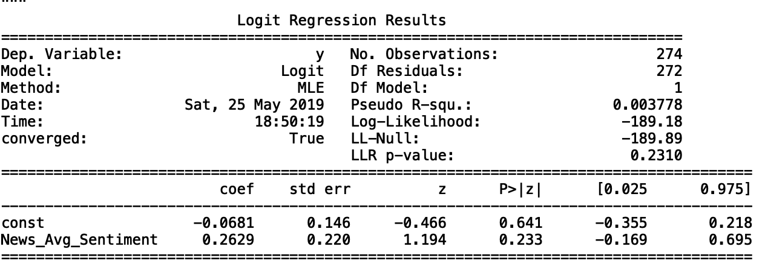
Model 1 – Logit model on news sentiment
Model Structure (Constructed on a daily basis)
$$logit{(y}_{t+1})=β_{0}+β_{1}x_{t}$$
$$y_{t+1}: \left\{\begin{aligned}1 if daily BTC return is+ve at time t+1 \\ 0 if daily BTC return is+ve at time t+1\end{aligned}\right.$$
$$x_{t}:Average Vader Score from news at time t$$
Regression result (Training data is from APR18-DEC18)
Trading Strategy
Buy if predicted probability > 0.5, short otherwise

Slide 12
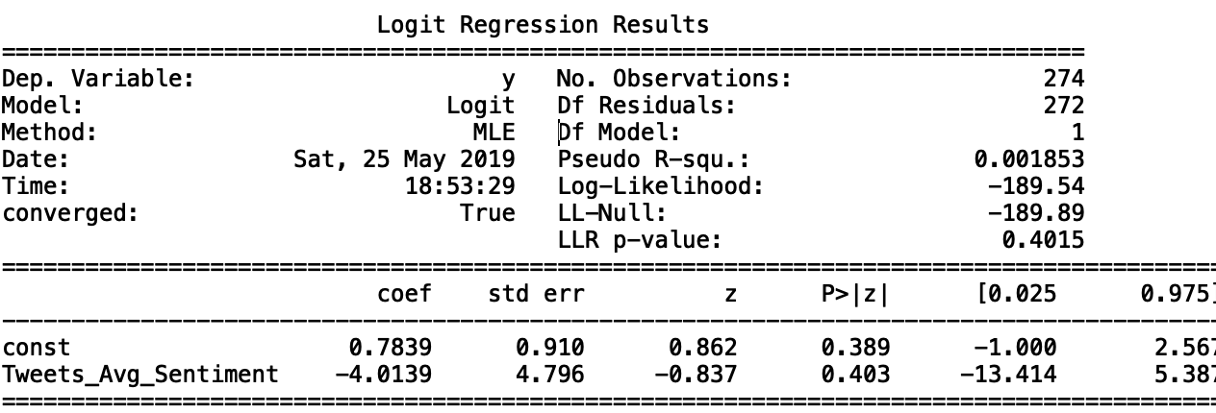
Model 2 – Logit model on Twitter sentiment
Model Structure (Constructed on a daily basis)
$$logit{(y}_{t+1})=β_{0}+β_{1}x_{t}$$
$$y_{t+1}: \left\{\begin{aligned}1 if daily BTC return is+ve at time t+1 \\ 0 if daily BTC return is+ve at time t+1\end{aligned}\right.$$
$$x_{t}:Average Vader Score from BTC tweets at time t$$
Regression result (Training data is from APR18-DEC18)
Trading Strategy
Buy if predicted probability > 0.5, short otherwise

Slide 13
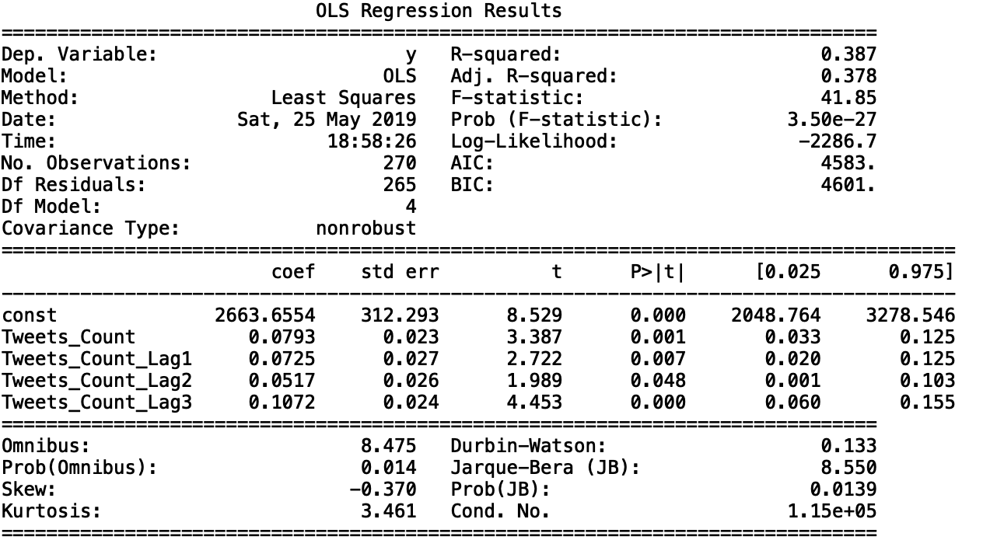
Model 3 – Linear regression model on time series of Tweets volume
Model Structure (Constructed on a daily basis)
$$y_{t+2}=β_{0}+β_{1}x_{t}+β_{2}x_{t−1}+β_{3}x_{t−2}+β_{4}x_{t−3}$$
$$y_{t+2}:open price of BTC at time t+2$$
$$x_{t}:Number of BTC Tweets at time t$$
Regression result (Training data is from APR18-DEC18)

Slide 14
Model 3 – Linear regression model on time series of Tweets volume
Trading Strategy
At the end of day $t$, We calculated predicted ${\hat{y}}_{t+2}$ and ${\hat{y}}_{t+1}$, i.e. the predicted open price of BTC at day $t+1$ & $t+2$ using the historical BTC Tweets volume.
If predicted ${\hat{y}}_{t+2}$ is higher than predicted ${\hat{y}}_{t+1}$, this indicates predicted increase of BTC price, i.e. buy signal for the trading strategy. Hence the trading strategy is constructed as:
$$Time t+1: \left\{\begin{aligned}\text{Predicted} {\hat{y}}_{t+2}>\text{Predicted} {\hat{y}}_{t+1}, buy at time t+1 \\ Otherwise, sell at time t+1\end{aligned}\right.$$

Slide 15
Backtesting Result
The trading strategies built on the previous 3 models were tested in the period of JAN19-MAR19 and their results are as follow. We have also compared the result the buy-and-hold and sell strategy.
Trading Strategy | Absolute Return | Accuracy in prediction of price movement | Annualized Volatility | Sharpe Ratio*
Model 1 - Based on Average News Sentiment | 39.49% | 62.22% | 42.54% | 376.45%
Model 2 - Based on Average Tweets Sentiment | 25.67% | 52.22% | 42.86% | 242.96%
Model 3 - Based on Tweets Volume | 41.70% | 61.11% | 42.49% | 397.96%
Benchmark - Buy-and-hold Strategy | 9.57% |  | 42.85% | 90.59%
Benchmark - Short Strategy | -9.57% |  | 42.85% | -90.59%
*Assuming risk free rate is 0% in computing the Sharpe Ratio.

Slide 16
Backtesting Result – Cumulative Absolute Return

Slide 17
Discussion on the result and further work
Both News Sentiment and Twitter Sentiment has a positive bias.
News Sentiment and Twitter Volume are shown to be good predictors on Bitcoin Price/ Return.
Further work to be considered
Build a consolidated model that account for news sentiment and twitter volume at the same time
Add more data sources on bitcoin related news
Backtesting against other cryptocurrencies, e.g. Ethereum (“ETH”)
Test against other Sentiment Analysis model in addition to VADER

